Slide 1
Efficient architectures for reconfigurable computing using RRAM and NEM relays
Electrical Engineering Qualifying Exam
Student: Akash Levy, Advisor: Priyanka Raina
Committee: S. Simon Wong, Roger Howe
Notes:
Let’s get started. So today, I’m going to be talking about my research into making ultra-efficient reconfigurable architectures through monolithic 3D integration of RRAM and NEM relays. I’m going to try to make this a short talk, but please feel free to stop me at any point with questions, and I’ll be happy to go deeper.

Slide 2
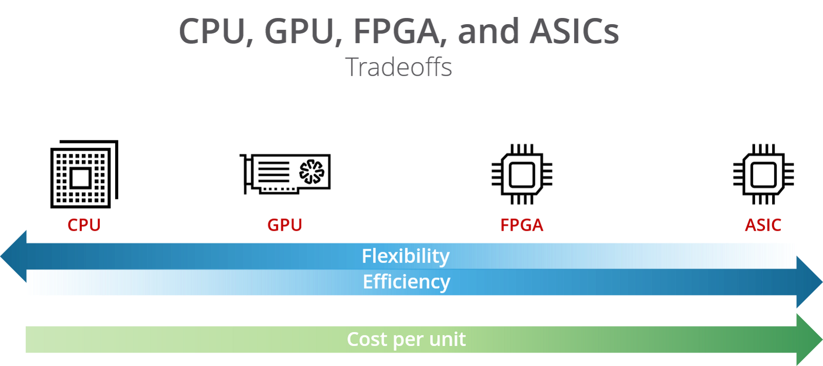
Designing an application today
Code
CUDA
RTL/HLS
RTL + Tapeout
CGRA
CGRA
CGRA
Source: https://hackernoon.com/a-gentle-introduction-to-hardware-accelerated-data-processing-81ac79c2105
Notes:
Today when designing an application, you have many platform options that provide tradeoffs between flexibility and cost.
Going from left to right, we have CPUs, then GPUs, then FPGAs (field programmable gate arrays), and finally ASICs (application-specific integrated circuits). So for situations where you care a lot about efficiency, you want to target a platform towards the right end of the spectrum. And that’s where a lot of research in computer architecture has been focusing today.
The problem with ASICs is that they are fixed-function and cannot be configured to run new applications. Usually, the NRE cost and design time of designing an ASIC greatly outweigh the efficiency benefits. Also, a common problem is that by the time ASICs go into production, they are almost obsoleted by their long design cycle. So a more desirable solution is to use a reconfigurable platform such as an FPGA. Unfortunately, there is a huge gap in resource efficiency between FPGAs and ASICs, which I’ll discuss more later.
More recently, we also have CGRAs, which are coarse-grained reconfigurable arrays. Typical CGRAs are quite similar to FPGAs but consist of coarse-grained logic blocks with wide datapaths that make common workloads more efficient than on FPGAs. I’m going to be focusing on CGRAs as my target platform for improving application efficiency, while maintaining flexibility.

Slide 3
Coarse Grained Reconfigurable Array (CGRA)
PE
MEM
PE
MEM
PE
MEM
PE
MEM
PE
MEM
PE
MEM
 | Processing Element (PE)
 | Memory (MEM)
 | Switch box (SB)
 | Connection box (CB)
PE
MEM
PE
MEM
Notes:
This is a high-level picture of a CGRA. I’m not going to go into too much detail on the architectural specifics, but I’ll give a quick overview of what’s going on. The array is composed of compute and memory tiles, interconnected by a reconfigurable routing fabric. A PE tile is a processing element tile, and it consists of a custom ALU for performing wide datapath computations, such as a 16-bit integer adds and multiplies. Each PE takes two inputs and produces one output. The two inputs are selected by the connection boxes (or CBs) shown by these multiplexers. The output is then sent to a switch box that connects different tiles in a desired fashion. This architecture enables many classes of data processing pipelines to be targeted efficiently from the high-level language called Halide.

Slide 4
Where does reconfigurability overhead come from?
Reconfigurable routing
Huge multiplexer cost
FPGA compared to ASIC:
Area 20-35x
Power 5-12x
Delay 3-4x
Source: Kuon, Ian, and Jonathan Rose. "Measuring the gap between FPGAs and ASICs." IEEE Transactions on computer-aided design of integrated circuits and systems 26, no. 2 (2007): 203-215.
Configuration memory
Startup time: SRAM-based FPGAs take milliseconds to seconds to copy configuration data from off-chip to on-chip
SRAM takes silicon area and consumes static power
Increases startup power/area/delay for intermittent applications
Both routing & config memory are control plane components
Notes:
As I mentioned earlier, there is a huge gap in performance and efficiency between reconfigurable platforms and fixed-function ASICs. So where does the overhead arise from?
The first answer is the reconfigurable routing; there is a huge cost to having multiplexers deciding where data should be routed, and a prior study showed there to be greatly increased area/power/delay in FPGAs.
The second answer is the configuration memory. It takes time to load configuration data into the on-chip registers—this can dominate the time and energy for intermittent applications that only need to run normally off instantly on. And also there is the silicon area and static power consumed by these registers.
Basically, we notice that most of the reconfigurability overhead comes from control plane components, rather than data plane components. So how can we integrate the control plane with lower overhead?

Slide 5
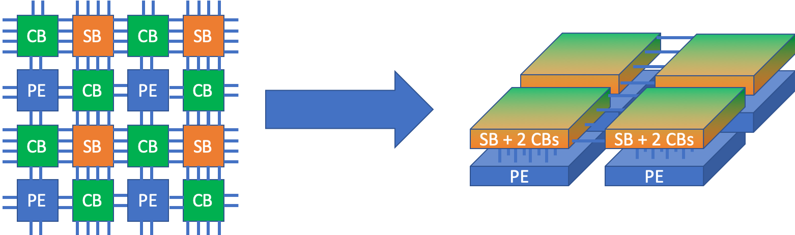
3D integration for CGRA control plane
Overhead comes from control plane components
3D advantages: less silicon area, shorter wire lengths, heterogeneous
Control plane components are less sensitive to write speed
Control/data plane: different physical planes of integrated 3D design
Control plane
Control plane
3D Integration
Data plane
Data plane
Notes:
3D integration is a solution to the overhead problem.
The advantages of 3D integration are clear; you are reducing silicon area by moving components upwards, your wire lengths are becoming shorter, and you can use other CMOS-compatible technologies.
Other things to note are that the control plane components are less sensitive to write speed since they are only written once ; the switching speed of a router between routing A versus B is less important than how fast it can propagate the signal. And for configuration memory, the write speed is much less important than the read speed.
The solution I propose is one that I think is very elegant: take the control and data planes and separate them into different layers of a 3D design. The intuition behind this is that this is essentially what an ASIC does. All of the routing and “configuration memory” is hard-coded in the wiring of the circuit, and all the wiring is done in 3D!

Slide 6
Coarse Grained Reconfigurable Array (CGRA)
PE
MEM
PE
MEM
PE
MEM
PE
MEM
Let’s zoom in…
PE
MEM
PE
MEM
 | Processing Element (PE)
 | Memory (MEM)
 | Switch box (SB)
 | Connection box (CB)
PE
MEM
PE
MEM
Notes:
So let’s zoom in on the PE tile to understand what we are hoping to move into 3D.

Slide 7
Connection Box (CB)
10:1 mux
10 vertical 16 bit tracks
5 driven up, 5 driven down
PE
A
CB
Each PE needs two 10:1 CB muxes and control registers for them
B
CB
There are similar 1 bit CBs for feeding 1 bit inputs from 10 horizontal and vertical 1 bit tracks
SB
10 horizontal 16 bit tracks
5 driven left, 5 driven right
Notes:
We have 10 vertical 16-bit tracks going up and down and we want to choose one of these tracks to have as an input. Each PE has two inputs, so we need two 10:1 connection boxes and control registers for them.

Slide 8
Coarse Grained Reconfigurable Array (CGRA)
PE
MEM
PE
MEM
PE
MEM
PE
MEM
Let’s zoom in…
PE
MEM
PE
MEM
 | Processing Element (PE)
 | Memory (MEM)
 | Switch box (SB)
 | Connection box (CB)
PE
MEM
PE
MEM
Notes:
Ok so now let’s zoom in on the switch box which is a little bit more complicated.

Slide 9
Switch Box (SB)
4
3
2
1
0
4
3
2
1
0
PE
Pipeline register
4
3
2
1
0
4
3
2
1
0
4
3
2
1
0
4
3
2
1
0
Each track needs 4:1 mux and 2:1 mux and control registers for them
4
3
2
1
0
4
3
2
1
0
Notes:
The switch box has 5 output tracks/side which can be routed from any of the 3 other sides or the PE. So we need a 4:1 mux for track selection. Then we need to allow for pipelining, so we have a pipeline register, which is a 2:1 mux. We are going to put all of these muxes into 3D as well as the control registers for them.

Slide 10
Emerging nanotechnologies for reconfigurability
CGRAs:
Reconfigurable architecture with multi-bit datapaths and wide ALUs
NEM relays:
Nano-scale mechanical switches monolithically integrated in 3D
Reduce area/power/delay overhead from reconfigurable interconnects
RRAM:
Non-volatile memory monolithically integrated in 3D
Reduce area/power/delay overhead from startup configuration
Notes:
So I am going to focus on improving CGRA performance with emerging nanotechnologies that can be integrated in 3D above CMOS layers.
NEM relays will be one focus. They have already been studied to some degree for FPGAs, but without rigorous study on how the relays would actually be integrated in 3D. I want to focus on the practical matter of integrating and routing CGRAs with NEM relays, to come up with realistic estimates of where it would make sense to use them.
RRAM will be the other focus. An RRAM FPGA was built by one of Simon’s students several years ago, and I have ideas for improving the design to involve less overhead.

Slide 11
NEM Relays: 3D Multiplexers
Notes:
Let’s first talk about NEM relays.

Slide 12
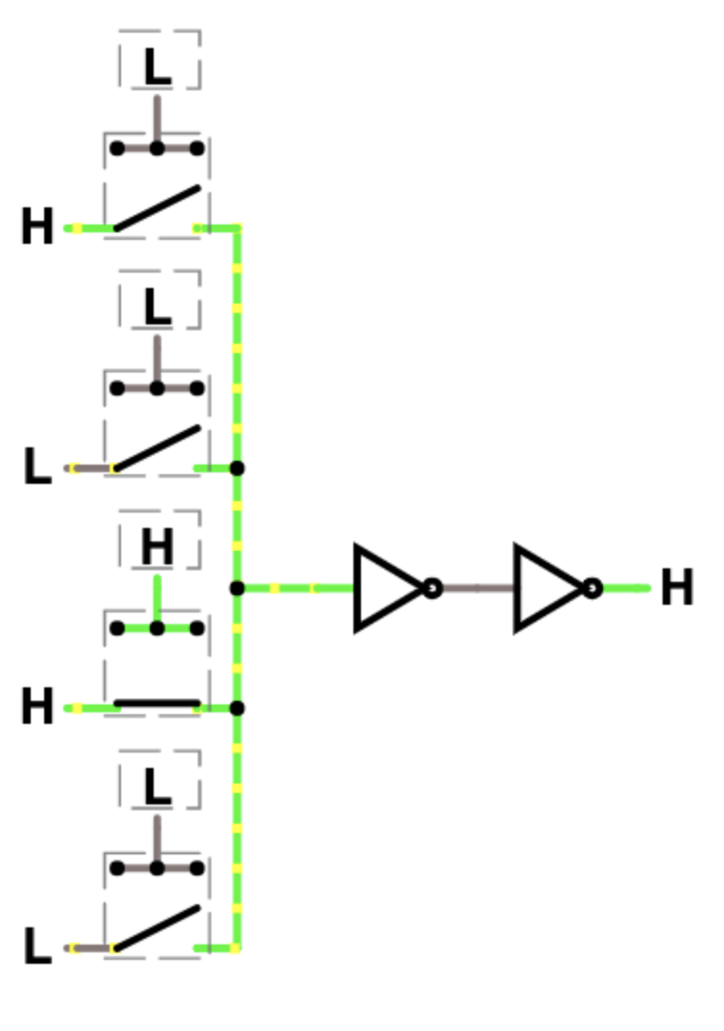
Making a Multiplexer with NEM Relays
Config reg
No threshold drop!
PTL-based design
in₀
in₀
NEM relay
in₁
in₁
out
out
in₂
in₂
Buffer not necessary if switch parasitics are small enough
V_{T} threshold drop
Requires PMOS feedback
in₃
in₃
Requires buffer to drive downstream circuits
Notes:
So now I want to talk briefly about how we can actually integrate relays to work as multiplexers. On the left, we have a mux based on pass transistor logic. Each of the dashed boxes represents a configuration register. Only one configuration register is on at any given time, hence it is called “one-hot”, and we have a one-hot multiplexer. Only the signal whose config register is on has its signal passed. However, the pass transistor introduces a threshold drop of VT and requires level restoration with a properly sized feedback buffer. This increases area, power, and delay in a digital circuit design. To incorporate NEM relays into this design, we can replace the pass transistors with NEM relays, which can be represented as switches.
Now there is no threshold drop, so the PMOS feedback is no longer required. Even buffers may not be required if the parasitics are small enough. If the effect of introducing NEM relays is to reduce the resistance, capacitance, and number of buffers required, then they can also result in improved power and delay in addition to area.

Slide 13
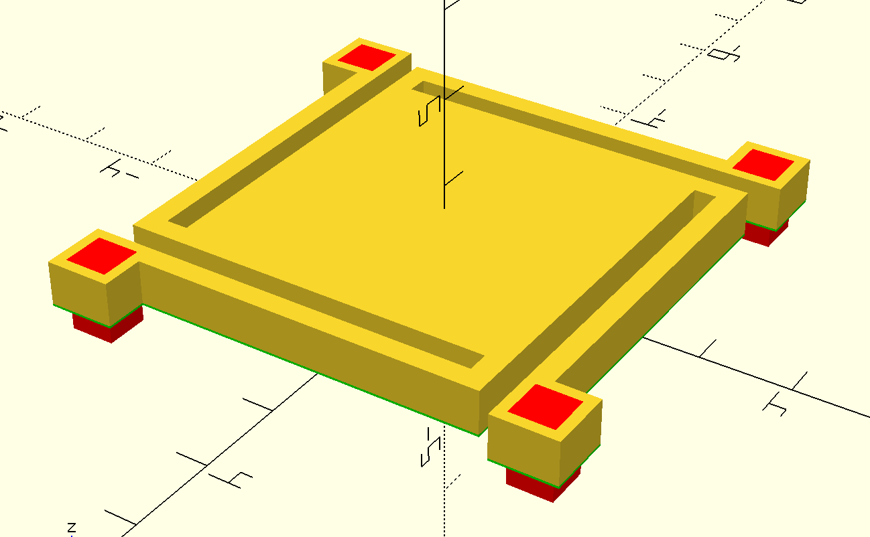
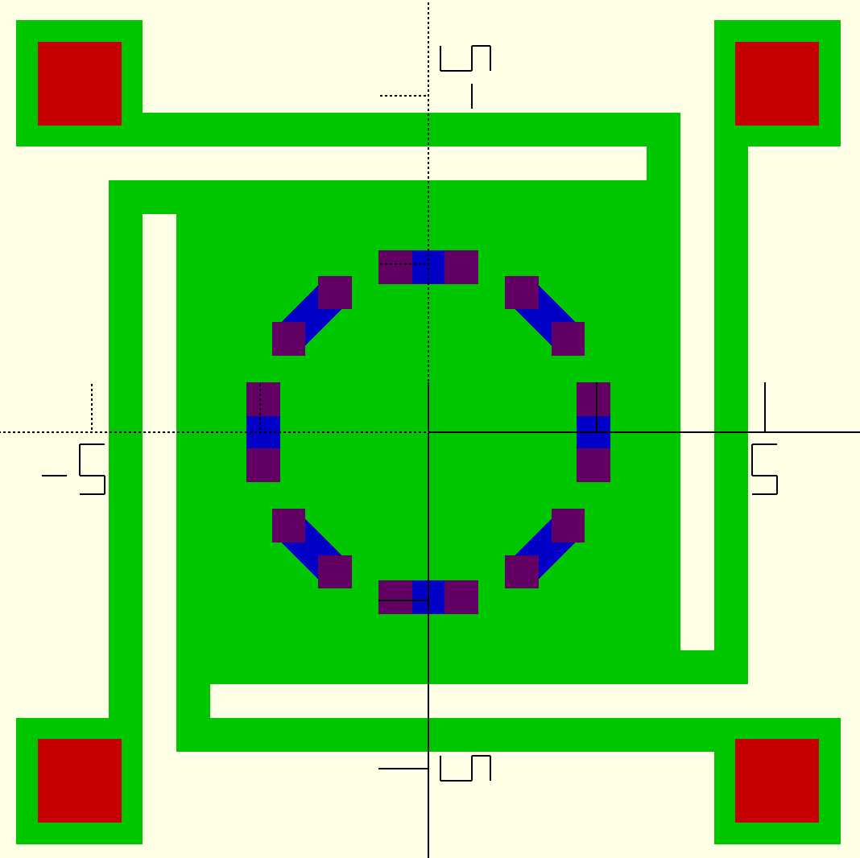
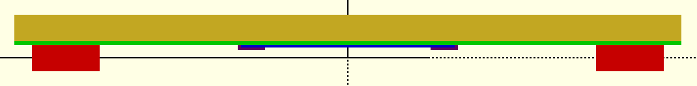
Parametric Clamped-Clamped Symmetric NEM Relay
Advantages: circular displacement contours for easy contact placement, equal contact resistance, better area utilization and tiling, larger contacts
Notes:
Last quarter, I developed a design for a symmetric relay similar to the Berkeley design that shows low actuation voltage, small area profile, and contact resistance in simulation. It is also parametric, so it can be easily sized and modified as desired. The goal is to use these designs to truly understand the limits to which we can scale the number of bits routed without contact resistance and parasitic capacitance increasing dramatically. This has not been studied in depth, and I think that understanding bit width scalability alone would be a significant contribution. I have a draft fabrication flow for the relays that I hope to start working on in the fall of this year.

Slide 14
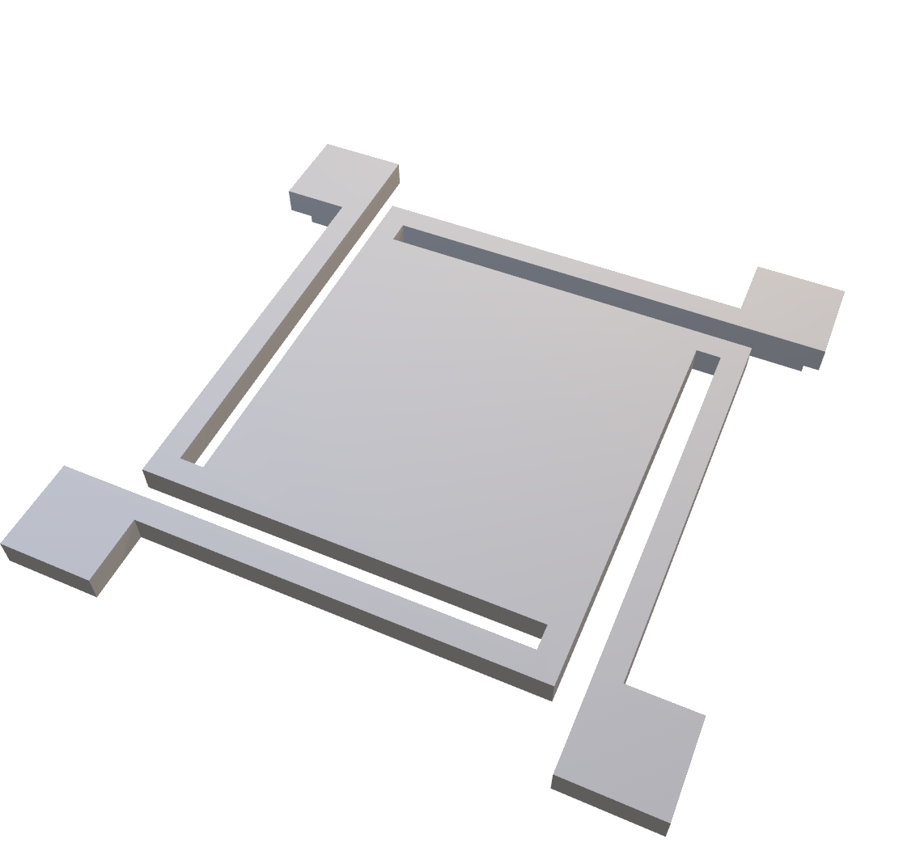
Parametric Clamped-Clamped Symmetric NEM Relay
﻿// RELAY PARAMETERS (lengths are in units of um)
g_act = 0.1; // actuation gap: gap between c
t_poly = 0.2; // thickness of poly-SiGe layer
L_plate = 3; // side length of parallel plate
L_cant = L_plate; // length of cantilever
W_cant = 0.2; // width of cantilever
g_cant = W_cant; // gap between plate and cantilever
L_via = 0.5; // side length of via
L_anc = L_via + 0.25; // side length of anchor attachment
circ_cont = 1; // circular or grid contact mode
n_cont = 16; // number of contacts
L_cont = 0.2; // side length of contact
r_cont = 1; // radius of contact circle
t_cont = 0.04; // thickness of contact
t_chan = 0.02; // thickness of channel
t_sub = 0.1; // substrate thickness
t_sp = 0.025; // thickness of spacer

Slide 15
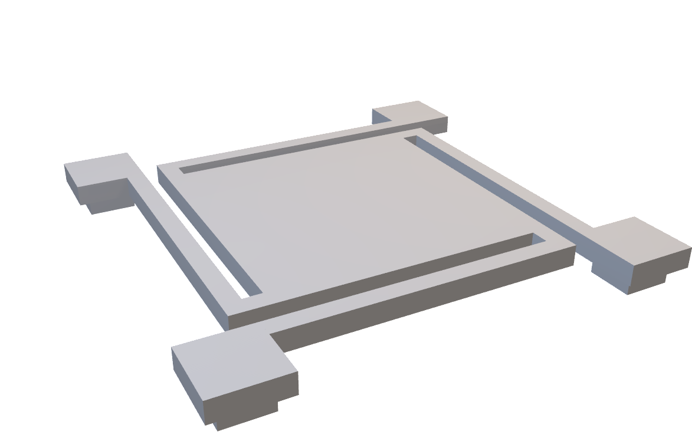
Parametric Clamped-Clamped Symmetric NEM Relay
﻿// RELAY PARAMETERS (lengths are in units of um)
g_act = 0.1; // actuation gap: gap between c
t_poly = 0.2; // thickness of poly-SiGe layer
L_plate = 3; // side length of parallel plate
L_cant = L_plate; // length of cantilever
W_cant = 0.2; // width of cantilever
g_cant = W_cant; // gap between plate and cantilever
L_via = 0.5; // side length of via
L_anc = L_via + 0.25; // side length of anchor attachment
circ_cont = 1; // circular or grid contact mode
n_cont = 16; // number of contacts
L_cont = 0.2; // side length of contact
r_cont = 1; // radius of contact circle
t_cont = 0.04; // thickness of contact
t_chan = 0.02; // thickness of channel
t_sub = 0.1; // substrate thickness
t_sp = 0.025; // thickness of spacer

Slide 16
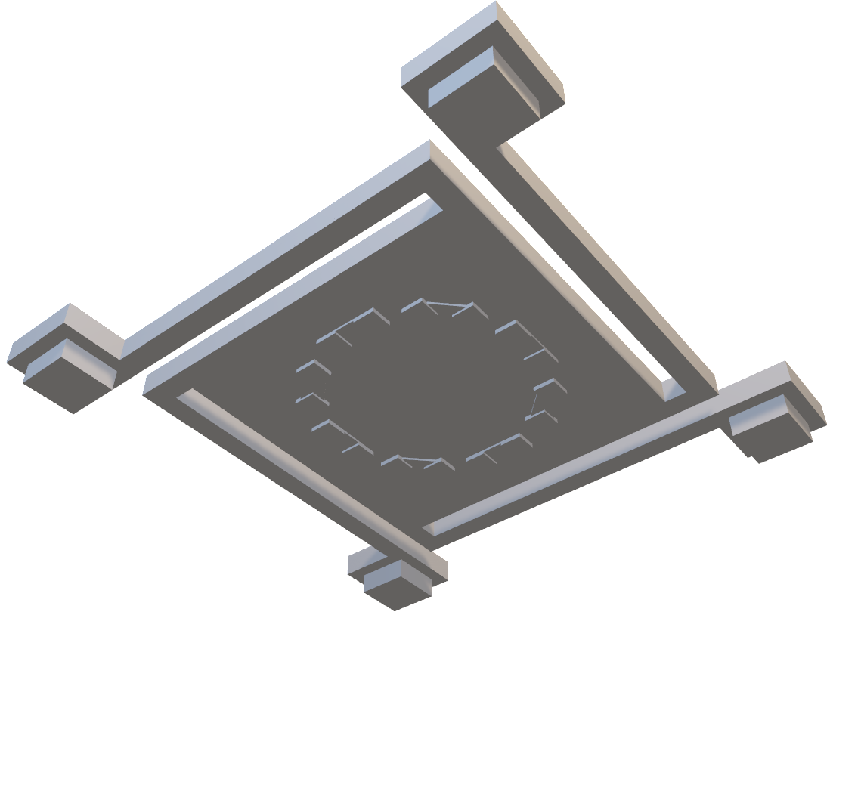
Parametric Clamped-Clamped Symmetric NEM Relay
﻿// RELAY PARAMETERS (lengths are in units of um)
g_act = 0.1; // actuation gap: gap between c
t_poly = 0.2; // thickness of poly-SiGe layer
L_plate = 3; // side length of parallel plate
L_cant = L_plate; // length of cantilever
W_cant = 0.2; // width of cantilever
g_cant = W_cant; // gap between plate and cantilever
L_via = 0.5; // side length of via
L_anc = L_via + 0.25; // side length of anchor attachment
circ_cont = 1; // circular or grid contact mode
n_cont = 16; // number of contacts
L_cont = 0.2; // side length of contact
r_cont = 1; // radius of contact circle
t_cont = 0.04; // thickness of contact
t_chan = 0.02; // thickness of channel
t_sub = 0.1; // substrate thickness
t_sp = 0.025; // thickness of spacer

Slide 17
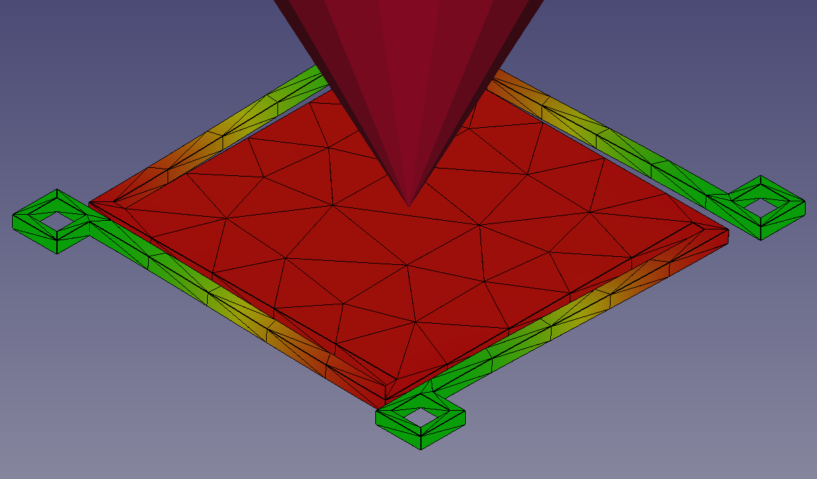
Parametric Clamped-Clamped Symmetric NEM Relay
Spring constant extracted from FEM, matches well with hand calcs
Will use oil ambient to reduce actuation voltages to CMOS range and reduce likelihood of electric breakdown
Plate size: 3µm x 3µm
Tile area: 4µm x 4µm
Minimum feature size: 100nm
Est. pull-in voltage: 5.69V
Est. pull-out voltage: 5.58V
Est. intrinsic contact resistance: 8.6Ω
Notes:
I extracted the relay spring constant from FEM and computed various relay properties from it.

Slide 18
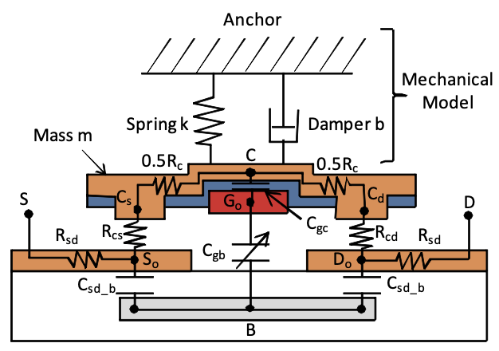
Next Steps with NEM Relay Project
Approximate Verilog-A model from layouts
Characterize Verilog-A model for Liberty models
FEM for more than just spring constant
More analysis of power, area, delay tradeoffs
Full analysis with Jade CGRA
Strain, catastrophic pull-in analysis
Fabrication and testing
Another application: relays for power gating
Lumped model from:
H. Kam, V. Pott, R. Nathanael, J. Jeon, E. Alon, and T.-J. K. Liu. Design and reliability
of a micro-relay technology for zero-standby-power digital logic applications. In
2009 IEEE International Electron Devices Meeting (IEDM), pages 1–4. IEEE, 2009.
Notes:
There are many next steps going forward with the NEM relay design project.

Slide 19
RRAM: 3D Configuration Memory

Slide 20
Making a Multiplexer with RRAM
RRAM
Config reg
PTL-based design
in₀
in₁
out
in₂
V_{T} threshold drop
Requires PMOS feedback
in₃
Requires buffer to drive downstream circuits
Notes:
When making a multiplexer that uses RRAM for the control bits, you are replacing the config registers

Slide 21
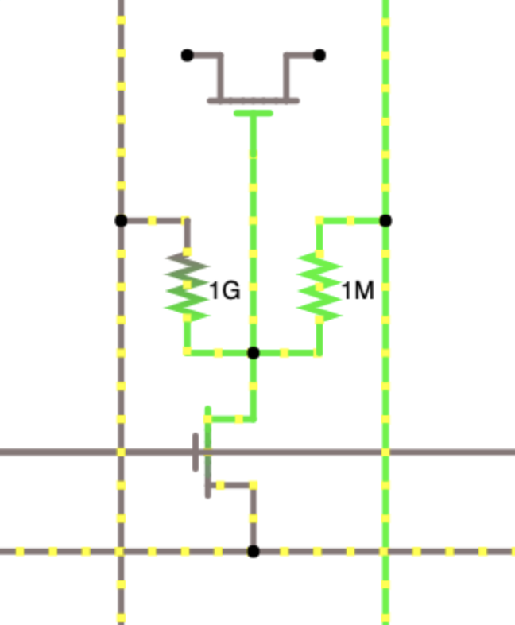
FPGA with 1T2R RRAM Config Memory
Left Bit Line
Routing Switch
Right Bit Line
Liauw, Young Yang, Zhiping Zhang, Wanki Kim, Abbas El Gamal, and S. Simon Wong. "Nonvolatile 3D-FPGA with monolithically stacked RRAM-based configuration memory." In 2012 IEEE International Solid-State Circuits Conference, pp. 406-408. IEEE, 2012.
Gnd
Vdd
BE
RRAM
BE
TE
TE
Gnd
Word Line
Select Transistor
Gnd
Source Line
1T2R Voltage Divider
Notes:
One way you can do this is using a programmable voltage divider. By having two RRAM cells act as a voltage divider, you can programmably control the gate voltage of the routing switch. This was first presented by one of Simon’s students at ISSCC in 2012.

Slide 22
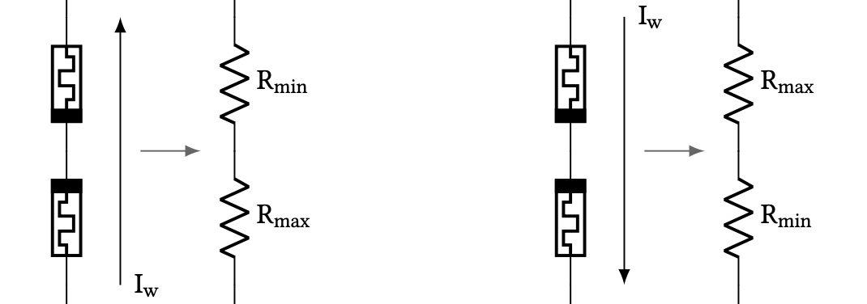
Complementary Resistive Switches
Can write two RRAM cells at once without select transistor
Arrange RRAM anti-serially and apply write voltage directionally to flip bit, read voltage at midpoint (voltage divider)
Notes:
Another way to build a programmable voltage divider is to put two RRAM cells antiserially and SET one while RESETing the other. This means that no programming transistor is required and the programming transistor can be at the circuit periphery instead.

Slide 23
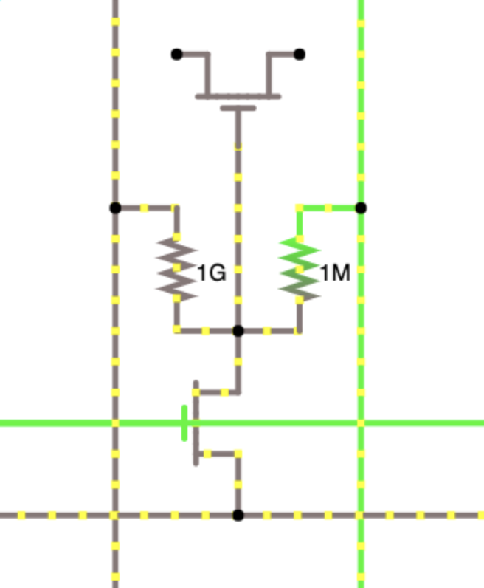
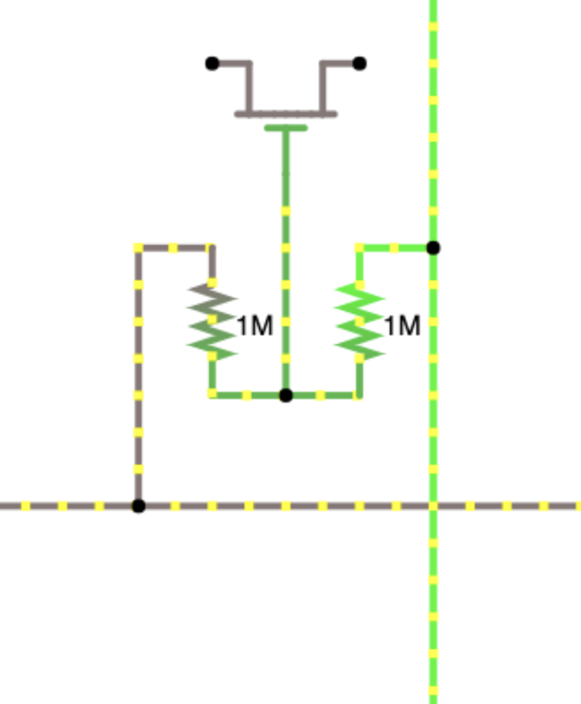
FPGA with RRAM Config Memory: SET R_{R}
Left Bit Line
Routing Switch
Right Bit Line
Routing Switch
Column Line
Float
V_{SET}
2V_{RESET}
BE
BE
BE
BE
TE
TE
TE
TE
V_{WL}
Gnd
Word Line
Row Line
Select Transistor
Gnd
Source Line
1T2R Voltage Divider*
CRS Voltage Divider
Notes:
So here is a comparison of how the two methods would work.

Slide 24
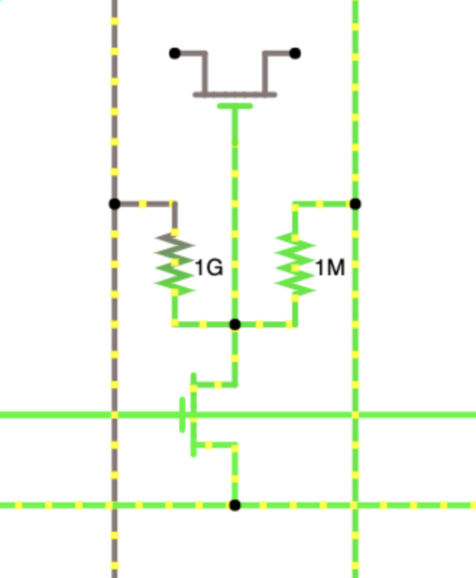
FPGA with RRAM Config Memory: RESET R_{L}
Left Bit Line
Routing Switch
Right Bit Line
Routing Switch
Column Line
Gnd
Float
2V_{RESET}
BE
BE
BE
BE
TE
TE
TE
TE
V_{WL}
Gnd
Word Line
Row Line
Select Transistor
V_{RESET}
Source Line
1T2R Voltage Divider
CRS Voltage Divider

Slide 25
FPGA with RRAM Config Memory: OPERATE
Left Bit Line
Routing Switch
Right Bit Line
Routing Switch
Column Line
Gnd
Vdd
Vdd
BE
BE
BE
BE
TE
TE
TE
TE
Gnd
Gnd
Word Line
Row Line
Select Transistor
Gnd
Source Line
1T2R Voltage Divider
CRS Voltage Divider

Slide 26
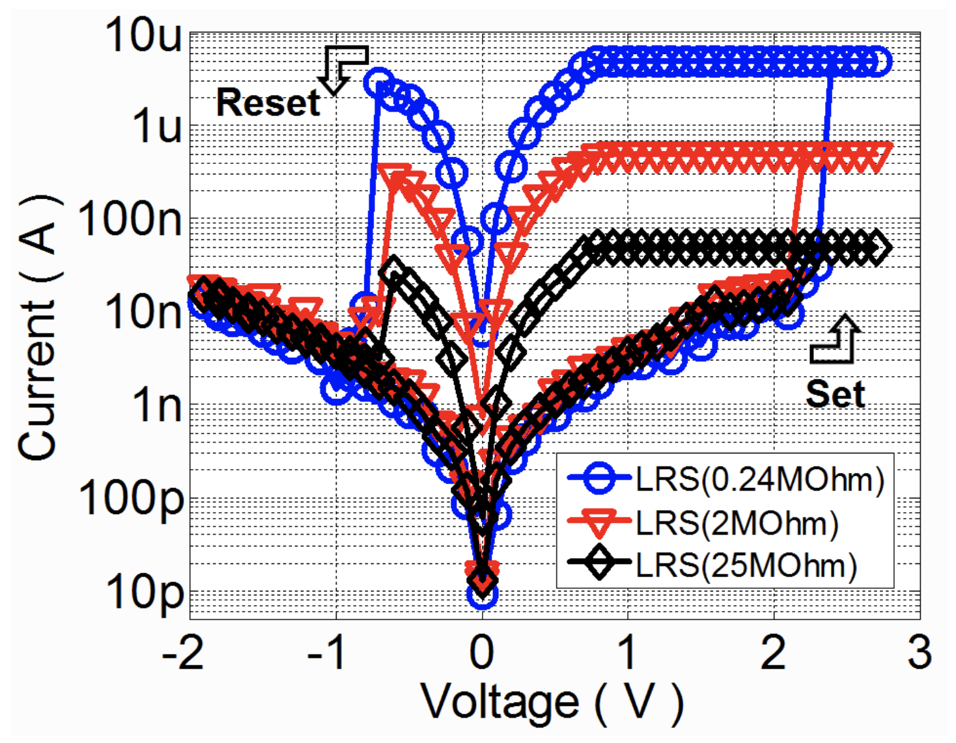
High-resistance CMOS-compatible AlO_{x}N_{y} RRAM
Kim, Wanki, Sung Il Park, Zhiping Zhang, and Simon Wong. "Current Conduction Mechanism of Nitrogen-Doped AlO_{x} RRAM." IEEE Transactions on Electron Devices 61, no. 6 (2014): 2158-2163.
Reuben, John, Dietmar Fey, and Christian Wenger. "A modeling methodology for Resistive RAM based on Stanford-PKU model with extended multilevel capability." IEEE Transactions on Nanotechnology 18 (2019): 647-65
Wang, Tianshi, and Jaijeet Roychowdhury. "Well-posed models of memristive devices." arXiv preprint arXiv:1605.04897 (2016).
Guan, Ximeng, Shimeng Yu, and H-S. Philip Wong. "A SPICE compact model of metal oxide resistive switching memory with variations." IEEE electron device letters 33, no. 10 (2012): 1405-1407.
Notes:
To understand how the CRS concept would work with high-resistance aluminum oxynitride RRAM, I adapted a SPICE version of the Stanford-PKU model and fitted it to parameters reported in the literature.

Slide 27
High-resistance CMOS-compatible AlO_{x}N_{y} RRAM
Kim, Wanki, Sung Il Park, Zhiping Zhang, and Simon Wong. "Current Conduction Mechanism of Nitrogen-Doped AlO_{x} RRAM." IEEE Transactions on Electron Devices 61, no. 6 (2014): 2158-2163.
Reuben, John, Dietmar Fey, and Christian Wenger. "A modeling methodology for Resistive RAM based on Stanford-PKU model with extended multilevel capability." IEEE Transactions on Nanotechnology 18 (2019): 647-65
Wang, Tianshi, and Jaijeet Roychowdhury. "Well-posed models of memristive devices." arXiv preprint arXiv:1605.04897 (2016).
Guan, Ximeng, Shimeng Yu, and H-S. Philip Wong. "A SPICE compact model of metal oxide resistive switching memory with variations." IEEE electron device letters 33, no. 10 (2012): 1405-1407.
Notes:
When looking at the CRS curves, we see a self-compliance effect… as soon as one cell starts SETting, the other starts RESETting and so you almost never have high current dissipation.

Slide 28
RRAM Process Flow Outline: Single Device
(Not drawn to scale)
SiO₂
SiO₂
SiO₂
Pt
Pt
Si
Si
Si
Start with Si wafer
Standard RCA Clean
Deposit 10nm Ti, 30nm Pt (AJA),
150nm SiO₂ (ccp-dep)
Pattern trenches (PT-Ox)
Post-metal clean
Active device area
SiO₂
SiO₂
SiO₂
SiO₂
SiO₂
SiO₂
TiN
TiN
AlO_{x}N_{y}
AlO_{x}N_{y}
AlO_{x}N_{y}
Pt
Pt
Pt
Si
Si
Si
Pattern top electrodes (PT-MTL)
Post-metal clean
Sputter 30nm TiN
Deposit 10nm AlO_{x}N_{y} (Fiji)
Notes:
And this quarter I’ve been working on a standard RRAM process flow in SNF that uses trenches to define the device area. This is an ongoing project and I am close to finishing the fabrication of the first single-cell devices. After this, I will work on patterning the bottom electrodes to form crossbar devices that can be tested with external equipment.

Slide 29
Hybrid RRAM-NEMS Design
Notes:
The two approaches I’ve brought up with RRAM and NEM relays are not mutually exclusive. They can both work well together and put the entire control plane in 3D.

Slide 30
Making a Multiplexer with RRAM and NEM Relays
RRAM
No threshold drop!
in₀
RESULT: Architecture is entirely free of transistors, so can be implemented 100% in BEOL i.e. 3D
NEM relay
in₁
out
in₂
Buffer not necessary if switch parasitics are small enough
in₃
Notes:
Lastly, I want to talk about how the ideas of using NEM relays and using RRAM fit together really nicely. If we use the RRAM as config bits, and the NEM relays as efficient 3D switches, we effectively have a control plane that is entirely free of transistors, so it can be implemented very nicely in BEOL.

Slide 31
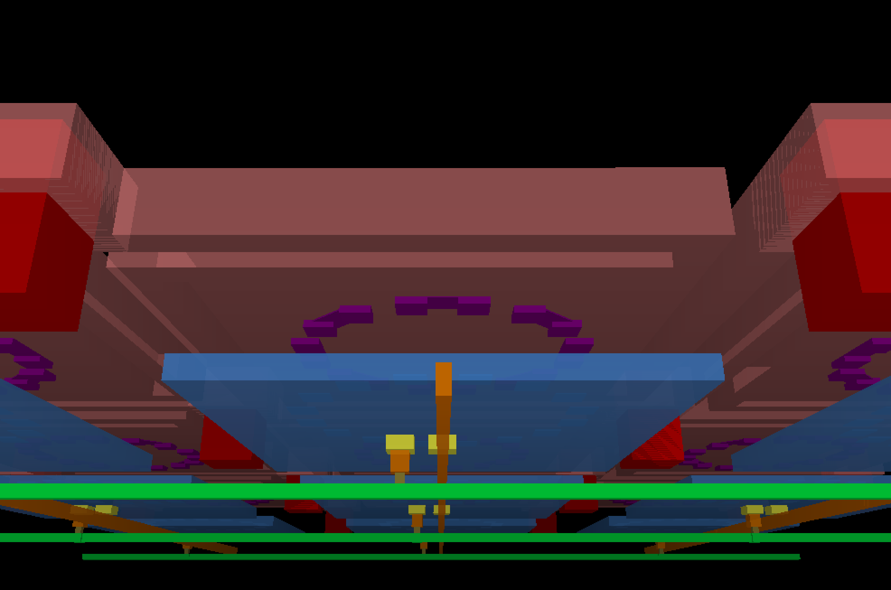
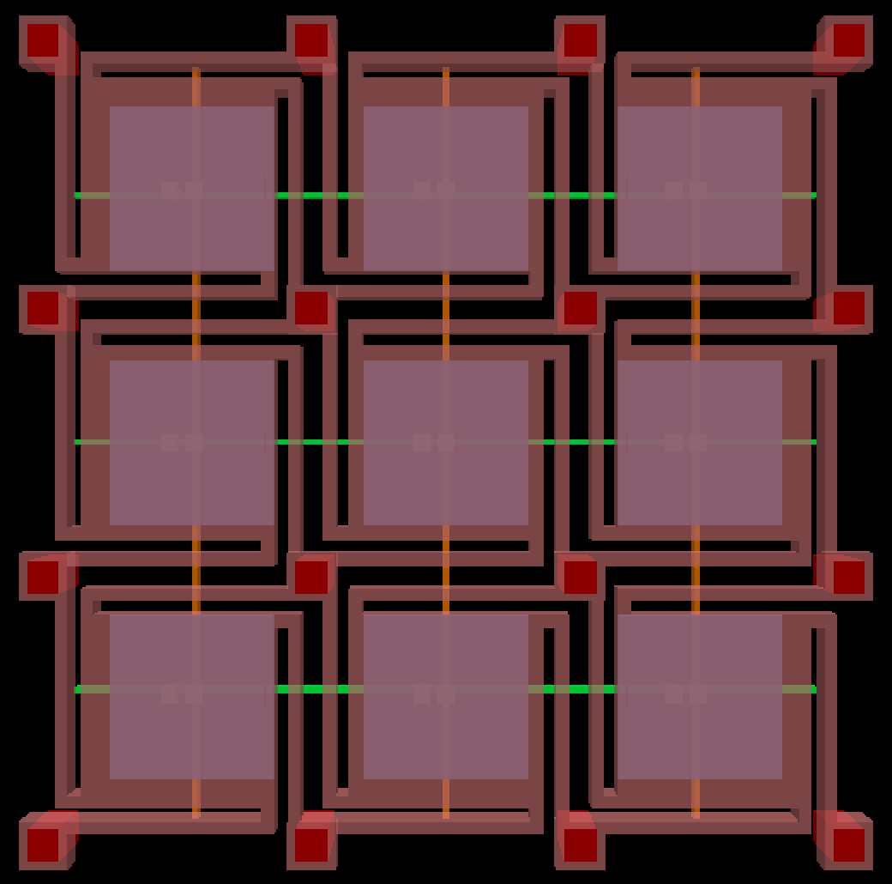
Hybrid Circuit Architecture Layout
Anchor
Contact
Relay Body
Channel
Gate (M9)
Column Line (M8)
RRAM
Row Line (M7)
Notes:
Here is a draft layout of what an 8-bit hybrid switch would look like. Notice that the tilling is very compact and area-efficient.

Slide 32
Current synthesis-based performance estimates
Non-volatility achieved
Area: 48% reduction
Power: 9% reduction
Critical path delay: equal (2ns)
Assumptions to revisit:
1kOhm relay contact resistance
Buffers inserted after relays (may not be necessary, delay/power ++)
Relay capacitance ignored
Vias for routing to top layer ignored in area analysis
Used DesignCompiler topographical mode to estimate wire lengths
Notes:
With simple SPICE models of RRAM and NEM relays, I performed a full synthesis-based performance estimate of a CGRA.

Slide 33
Coming up
(Each highlight indicates results for a different potential paper)
Simulation/Modeling:
Row/column drivers for CRS/relays
FEM of relay pull-in/pull-out
Parasitic extraction for NEM relays
Scalability of CRS
VLSI/Circuit Design:
Row/column drivers for CRS/relays
3D place-and-route with CGRA
Fabrication:
AlO_{x}N_{y} RRAM process
Ultra-scaled w/e-beam litho
CRS devices
Multi-pole NEM relay process
Study of contact resistance
Hybrid circuit proof-of-concept
Full demo
Architectural Analysis:
Energy/delay/area benefits (with parasitics)
Study of how different applications are affected

Slide 34
Conclusion
Fully 3D circuit architecture using two emerging nanotechnologies
Can enable ultra-efficient reconfigurable computing
Clear path forward for PhD work
RRAM/NEM relay processes
Architectural analysis with AHA CGRA

Slide 35
Thank you!
Questions?
Notes:
Control plane vs. data plane

Slide 36
MORE DETAILS
Backup Slides Below

Slide 37
Outline
CGRA design with RRAM and multi-bit NEM relays
Optimizing NEM relay design for multi-bit routing: experiment/theory
Analysis: area/power/delay benefits of NEM routers/RRAM in CGRAs
Experimental demonstration of hybrid RRAM/NEM relay scheme
Experimental/theoretical demonstrations with 2R AlO_{x}N_{y}
Complementary Resistive Switching (CRS)
Differential Crosspoint (DX) array
Electrical properties of sub-micron cells: scaling theory
Multi-bit-per-cell RRAM
Analog vs. digital comparison
Optimal programming approaches

Slide 38
CGRA design with RRAM and multi-bit NEM relays
Project Description

Slide 39
Designing an application today
Code
CUDA
RTL/HLS
RTL + PNR + Tapeout
Source: https://hackernoon.com/a-gentle-introduction-to-hardware-accelerated-data-processing-81ac79c2105
Notes:
Today we have many options for designing an application. Here’s a diagram showing the supposed tradeoffs between different application design flows.
Flexibility = What applications can be run on it
Efficiency = EDP
Cost per unit = NRE cost
We have CPUs which you run software on, GPUs which you run CUDA software on, FPGAs which you compile RTL to (or use HLS), and ASICs which have the most complex design flow.
More recently, we also have CGRAs, which are coarse-grained FPGAs, meaning they replace some LUTs with common logic structures. These have a somewhat interesting profile on this scale.
CGRAs are FPGAs that tradeoff a small amount of flexibility for a decent amount of efficiency (depending on workload though)
Same design flow should mean same cost per unit

Slide 40
Where does reconfigurability overhead come from?
Why does reconfigurability hurt efficiency?
LUTs are less efficient than standard cells
Unutilized logic components
Reconfigurable routing
Increases area (80-90% of FPGA area is occupied by routing)
Increases power (5-12x) compared to ASIC
Increases delay (3-4x) compared to ASIC
Startup configuration time
SRAM-based FPGAs take milliseconds to seconds to copy configuration memory from off-chip to configuration SRAM
Increases startup power/area/delay for intermittent applications
Notes:
So we need to think about what causes this overhead. There are three main causes.

Slide 41
Reducing reconfigurable routing overhead using emerging nanotechnologies
NEM relays:
Reconfigurable switches monolithically integrated in 3D
Reduce area/power/delay overhead from reconfigurable interconnects
RRAM:
Non-volatile memory monolithically integrated in 3D
Reduce area/power/delay overhead from startup configuration
Result:
Drastically reduced routing overhead
No startup reconfiguration cost
Notes:
Result:
CGRAs become competitive with ASICs in terms of performance
CGRAs become competitive with ASICs for “normally off, instantly on”

Slide 42
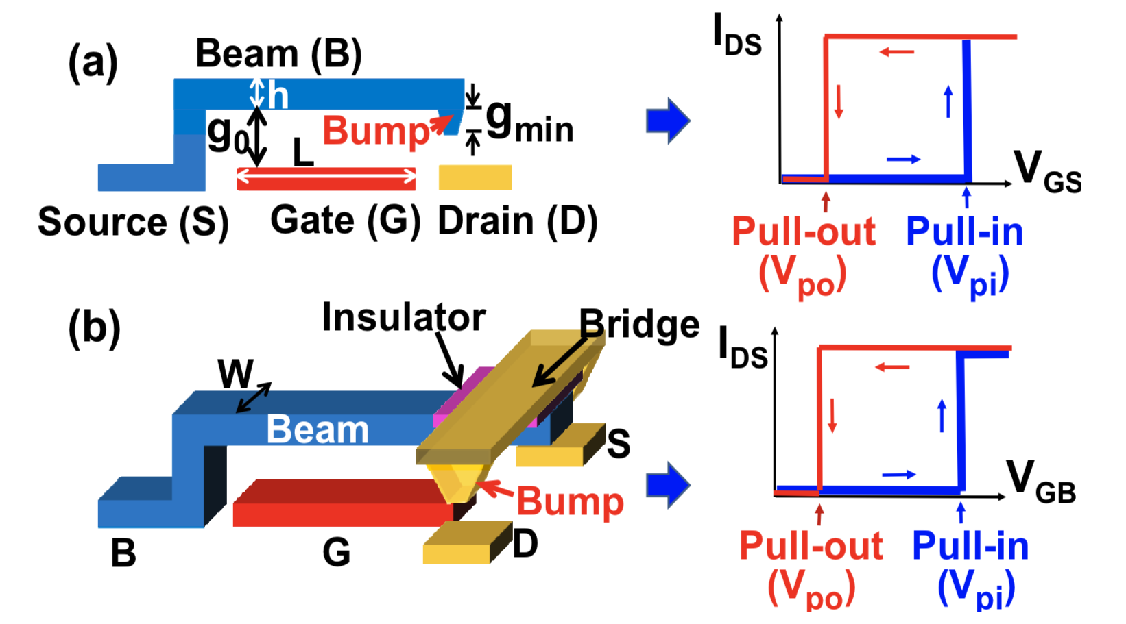
3T & 4T NEM Relays
Source: C. Chen, R. Parsa, N. Patil, S. Chong, K. Akarvardar, J. Provine, D. Lewis, J. Watt, R. T. Howe, H.-S. P. Wong, et al., “Efficient FPGAs using nanoelectromechanical relays,” in Proceedings of the 18th annual ACM/SIGDA international symposium on Field programmable gate arrays, pp. 273–282, ACM, 2010.

Slide 43
Previous work on NEM relays for FPGAs
C. Chen et al., “Efficient FPGAs using nanoelectromechanical relays,” in Proceedings of the 18th annual ACM/SIGDA international symposium on Field programmable gate arrays, pp. 273–282, ACM, 2010.
Half-select programming scheme was used for the NEM relays, verified expt. small array size
43.6% footprint area reduction, 37% leakage power reduction, and up to 28% critical path delay reduction
C. Chen et al., “Nano-electro-mechanical relays for FPGA routing: Experimental demonstration and a design technique,” in Design, Automation & Test in Europe Conference & Exhibition (DATE), 2012, pp. 1361–1366, IEEE, 2012.
3D place-and-route scheme with NEM-based LUTs and routers
Maximum of 41.9% performance gain
Both papers used somewhat optimistic device parameters that have not been physically realized yet
Assumed low contact resistance, no coupling capacitances, negligible via resistance, infinite space available for relays...
Are these reasonable assumptions? Work with a real design/model to find out

Slide 44
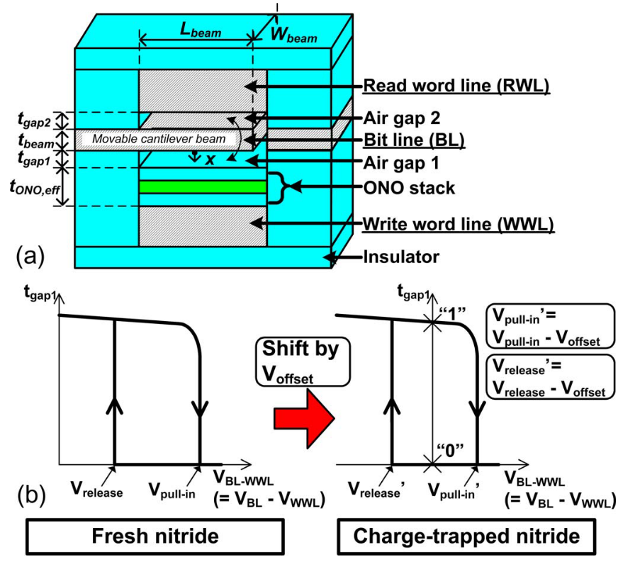
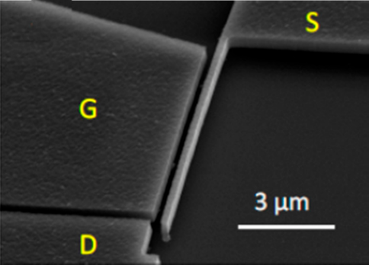
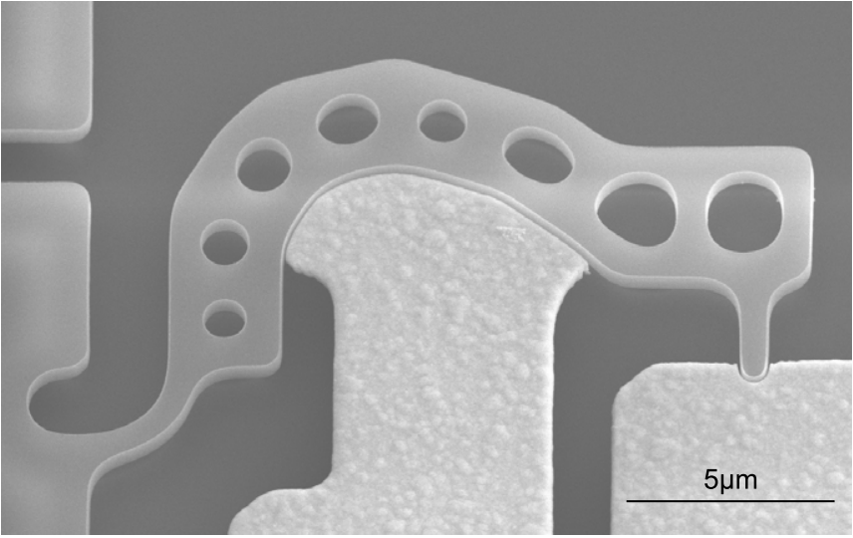
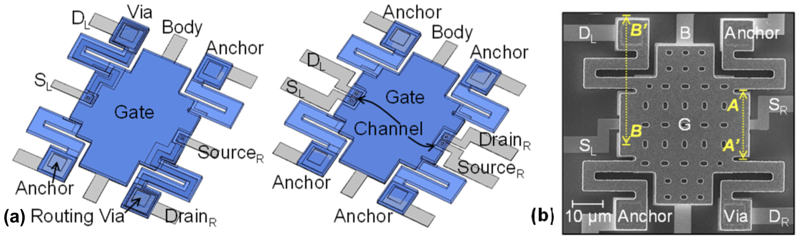
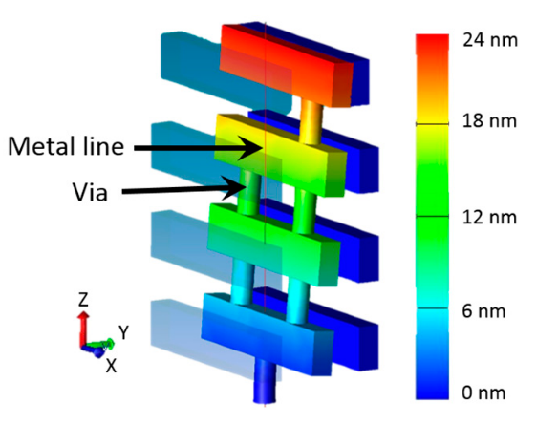
Types of Relays
Lateral beam
(3T, volatile)
Curved lateral
(3T, volatile)
NEMory (3T, non-volatile)
Clamped-clamped vertical
(4T, volatile)
Vertical metal line-via
(3T, 4T, non-volatile)

Slide 45
Modern Clamped-Clamped 4T NEM Relay
Source: Ye, Z. A., S. Almeida, M. Rusch, A. Perlas, W. Zhang, U. Sikder, J. Jeon, V. Stojanović, and T-JK Liu. "Demonstration of 50-mV Digital Integrated Circuits with Microelectromechanical Relays." In 2018 IEEE International Electron Devices Meeting (IEDM), pp. 4-1. IEEE, 2018.

Slide 46
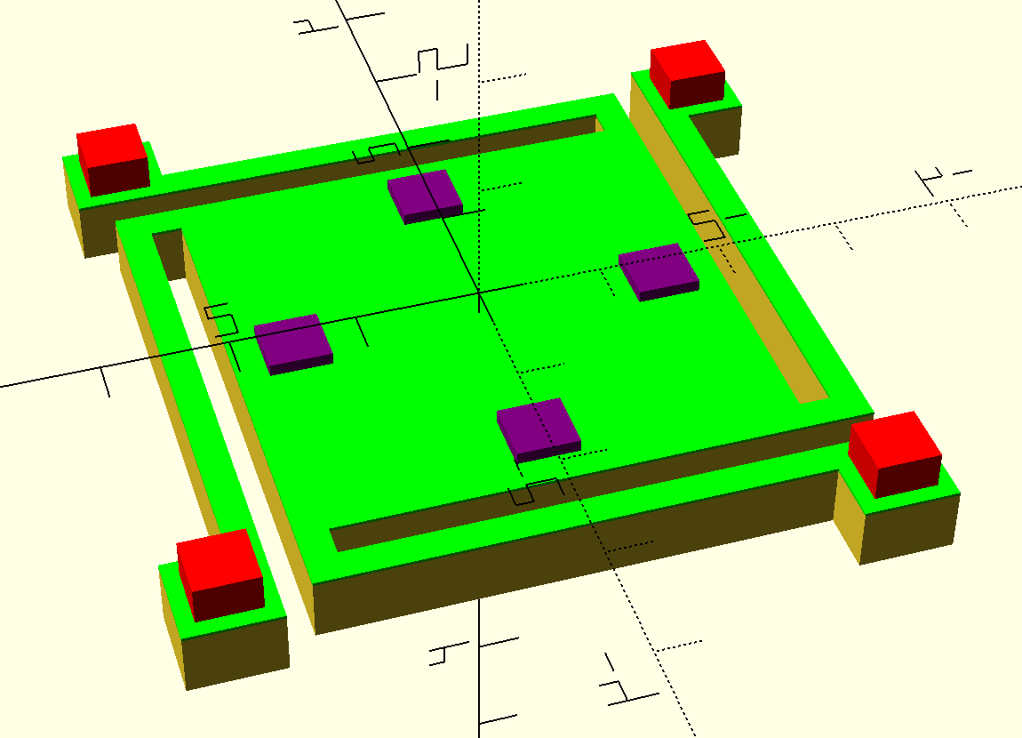
Parametric Clamped-Clamped Symmetric NEM Relay
Advantages: circular displacement contours for easy contact placement, equal contact resistance, better area utilization, larger contacts

Slide 47
Parametric Clamped-Clamped Symmetric NEM Relay
// RELAY PARAMETERS (lengths are in units of um)
g_act = 0.08; // actuation gap: gap between
t_poly = 0.2; // thickness of poly-SiGe layer
L_plate = 5; // side length of parallel plate
L_cant = L_plate; // length of cantilever
W_cant = 0.2; // width of cantilever
g_cant = W_cant; // gap between plate and cantilever
L_via = 0.5; // side length of via
L_anc = L_via + 0.25; // side length of anchor attachment
n_cont = 4; // number of contacts
L_cont = 0.5; // side length of contact
r_cont = 1.5; // radius of circle along which to place contacts
t_cont = 0.04; // thickness of contact
t_sub = 0.1; // substrate thickness
t_sp = 0.025; // thickness of spacer

Slide 48
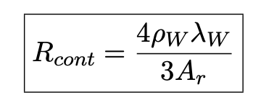
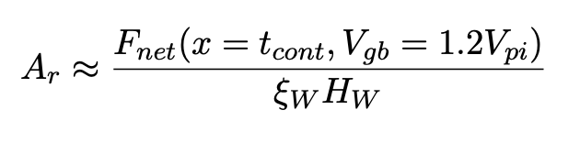
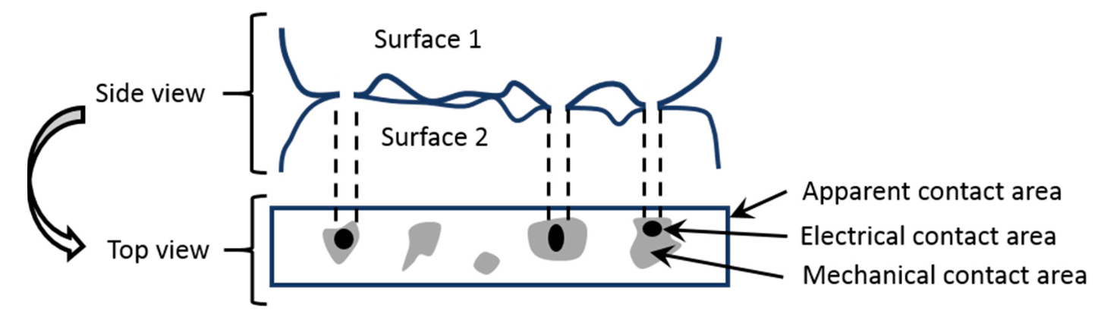
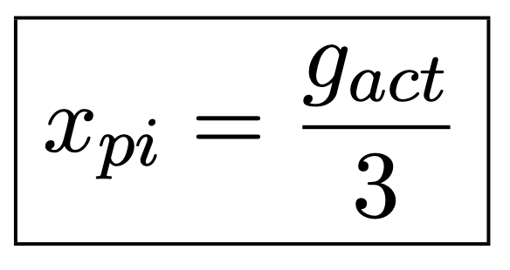
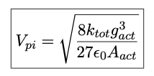
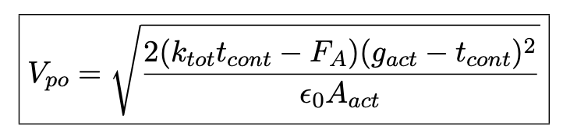
Models and FEM of NEM Relay
Spring constant determination with FreeCAD static analysis (Netgen, CalculiX for meshing/solving)

Slide 49
Next Steps with NEM Relay Project
Approximate Verilog-A model from layouts
Characterization of Verilog-A model for Liberty models
FEM for more than just spring constants
More analysis of power, area, delay tradeoffs
Routing of contacts to vias
Multi-spirals for lower spring constants
Analysis with Jade CGRA
Strain, catastrophic pull-in analysis
Another application: relays for power gating
Lumped model from:
H. Kam, V. Pott, R. Nathanael, J. Jeon, E. Alon, and T.-J. K. Liu. Design and reliability
of a micro-relay technology for zero-standby-power digital logic applications. In
2009 IEEE International Electron Devices Meeting (IEDM), pages 1–4. IEEE, 2009.

Slide 50
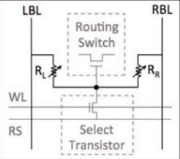
Previous Work on RRAM for FPGAs
Y. Y. Liauw, Z. Zhang, W. Kim, A. El Gamal, and S. S. Wong, “Nonvolatile 3D-FPGA with monolithically stacked RRAM-based configuration memory,” in Solid-State Circuits Conference Digest of Technical Papers (ISSCC), 2012 IEEE International, pp. 406–408, IEEE, 2012.
1T2R structure with two RRAM cells having opposite resistance states
High-resistance voltage divider controlling a pass transistor
Layout/simulations @ 65 nm technology node showed 57% smaller die area and a 28% lower energy-delay-product (EDP) than SRAM-based design
Non-volatile configuration memory enables instant-on operation

Slide 51
Complementary Resistive Switches
Can write two RRAM cells at once without select transistor
Arrange RRAM anti-serially and apply write voltage directionally to flip bit, read voltage to read out logic level at midpoint

Slide 52
High-resistance CMOS-compatible AlO_{x}N_{y} RRAM
Kim, Wanki, Sung Il Park, Zhiping Zhang, and Simon Wong. "Current Conduction Mechanism of Nitrogen-Doped AlO_{x} RRAM." IEEE Transactions on Electron Devices 61, no. 6 (2014): 2158-2163.
Reuben, John, Dietmar Fey, and Christian Wenger. "A modeling methodology for Resistive RAM based on Stanford-PKU model with extended multilevel capability." IEEE Transactions on Nanotechnology 18 (2019): 647-65
Wang, Tianshi, and Jaijeet Roychowdhury. "Well-posed models of memristive devices." arXiv preprint arXiv:1605.04897 (2016).
Guan, Ximeng, Shimeng Yu, and H-S. Philip Wong. "A SPICE compact model of metal oxide resistive switching memory with variations." IEEE electron device letters 33, no. 10 (2012): 1405-1407.

Slide 53
High-resistance CMOS-compatible AlO_{x}N_{y} RRAM
Kim, Wanki, Sung Il Park, Zhiping Zhang, and Simon Wong. "Current Conduction Mechanism of Nitrogen-Doped AlO_{x} RRAM." IEEE Transactions on Electron Devices 61, no. 6 (2014): 2158-2163.
Reuben, John, Dietmar Fey, and Christian Wenger. "A modeling methodology for Resistive RAM based on Stanford-PKU model with extended multilevel capability." IEEE Transactions on Nanotechnology 18 (2019): 647-65
Wang, Tianshi, and Jaijeet Roychowdhury. "Well-posed models of memristive devices." arXiv preprint arXiv:1605.04897 (2016).
Guan, Ximeng, Shimeng Yu, and H-S. Philip Wong. "A SPICE compact model of metal oxide resistive switching memory with variations." IEEE electron device letters 33, no. 10 (2012): 1405-1407.

Slide 54
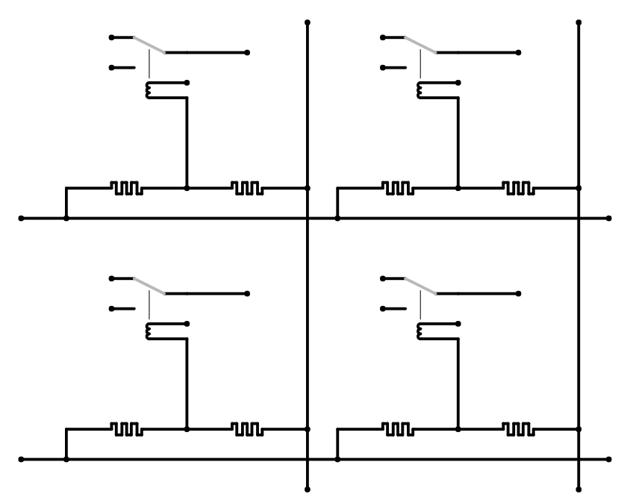
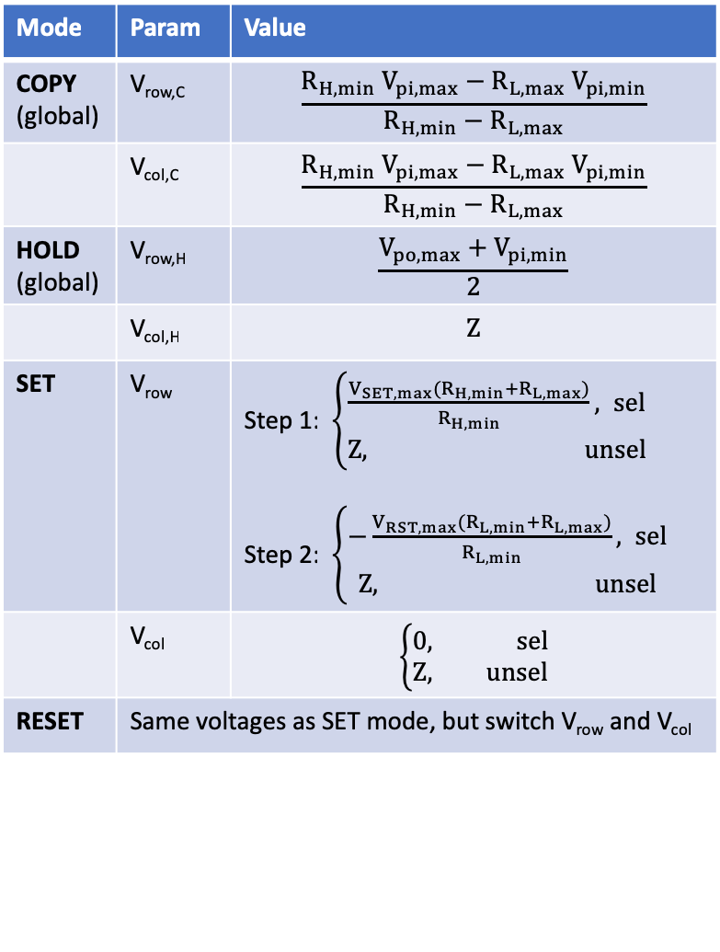
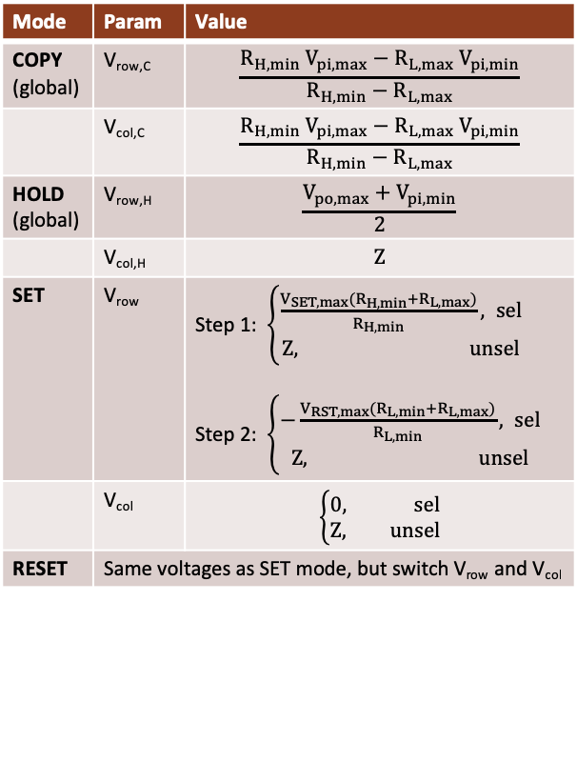
Hybrid Circuit Architecture
V_{col,2}
Mode | Param | Value
COPY (global) | V_{row,C} | $$\frac{R_{H,min} V_{pi,max}−R_{L,max} V_{pi,min}}{R_{H,min}−R_{L,max}}$$
 | V_{col,C} | $$\frac{R_{H,min} V_{pi,max}−R_{L,max} V_{pi,min}}{R_{H,min}−R_{L,max}}$$
HOLD (global) | V_{row,H} | $$\frac{V_{po,max}+V_{pi,min}}{2}$$
 | V_{col,H} | $$Z$$
SET | V_{row} | Step 1: $\left\{\begin{aligned}\frac{V_{SET,max}{{(R}_{H,min}+R}_{L,max})}{R_{H,min}}, sel \\ Z, unsel\end{aligned}\right.$ Step 2: $\left\{\begin{aligned}−\frac{V_{RST,max}{{(R}_{L,min}+R}_{L,max})}{R_{L,min}}, sel \\ Z, unsel\end{aligned}\right.$
 | V_{col} | $$\left\{\begin{aligned}0, sel \\ Z, unsel\end{aligned}\right.$$
RESET | Same voltages as SET mode, but switch V_{row} and V_{col}
V_{col,1}
src_{1,1}
src_{1,2}
drn_{1,1}
drn_{1,2}
V_{g}
-
+
+
-
V_{row,1}
src_{2,1}
src_{2,2}
drn_{2,1}
drn_{2,2}
V_{g}
V_{row,2}
out
Hysteretic 4T NEM Router
RRAM Cell
(a)
(b)
Notes:
Key idea: use RRAM to actuate the NEM relays
Entirely back-end-of-line (0T)
1N1R design
Need a good way to actuate
Poly layers are annoying to get to
RRAM properties have to match NEM relays’

Slide 55
Hybrid Circuit Architecture Operation Modes
gnd
V_{hold}
Relay is actuated by RRAM
Relay retains state
Another option is to remove HOLD mode and use COPY mode only if hysteresis window varies device-to-device
This may be a more realistic option given the variability reported in literature
Using a high-resistance RRAM reduces the static leakage current in this scenario
src_{1,1}
src_{1,1}
drn_{1,1}
Leakage path
drn_{1,1}
Gate drive
Hold bias
V_{hold}
-
+
+
-
-
+
+
-
V_{copy}
V_{hold}
COPY mode
HOLD mode
gnd
V_{SET}
src_{1,1}
src_{1,1}
drn_{1,1}
Current path
drn_{1,1}
Transition to HRS
Transition to LRS
-
+
+
-
-
+
+
-
V_{SET}
gnd
Transition to LRS
Current path
Transition to HRS
SET mode
RESET mode
Notes:
Key idea: use RRAM to actuate the NEM relays
Entirely back-end-of-line (0T)
1N1R design
Need a good way to actuate
Poly layers are annoying to get to
RRAM properties have to match NEM relays’

Slide 56
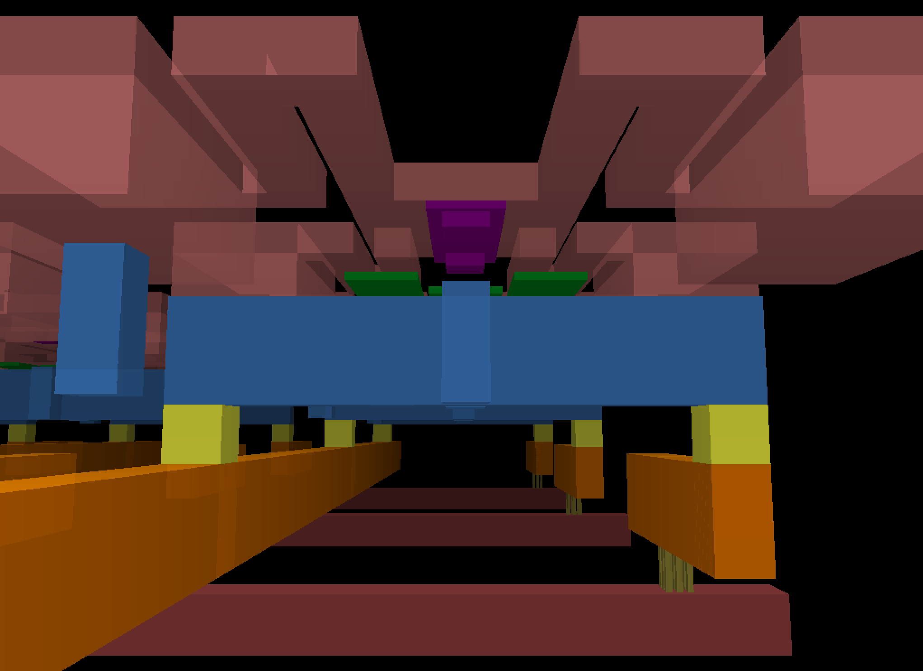
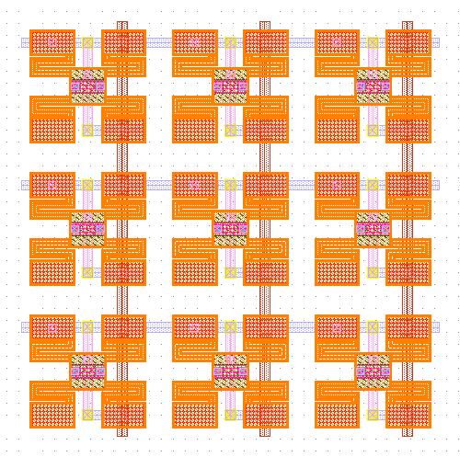
RRAM/NEMS switch layouts
NEM
Relay
Anchor
NEM
Body
NEM
Relay
Anchor
Channel
Dimple
Gate body
S/D contact
Gnd Pin for Anchor
Gate line (M9)
RRAM
RRAM
4T
Row line (M8)
Vias
Column line (M7)

Slide 57
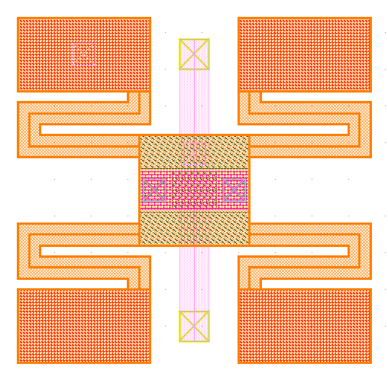
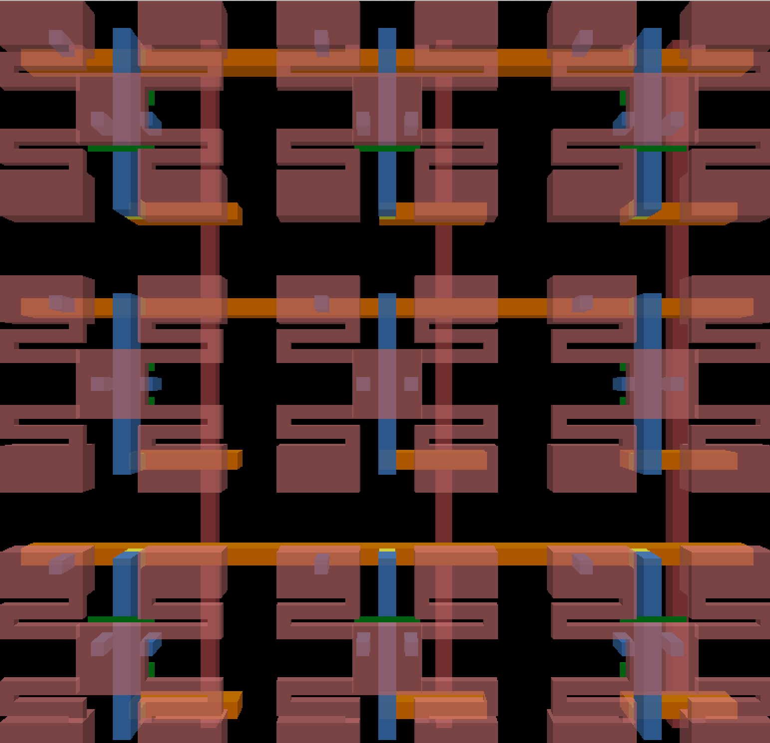
RRAM/NEMS switch early layouts (~5um x 5um)
Custom technology based on SAED32 PDK. 6 new layers added: RRAM (between M8/M9), NEMDIMP, NEMANC, NEMCHAN, NEMBEAM, NEMBODY
Notes:
TODO: add measurements on critical dimensions

Slide 58
Architectural analysis and area benefits of RRAM/NEMS-based CGRA
Used Jade CGRA synthesized with TSMC40 LP/HVT library to determine area benefits
Analyzed area effect of putting SB/CB in 3D
>2X area reduction possible:

Slide 59
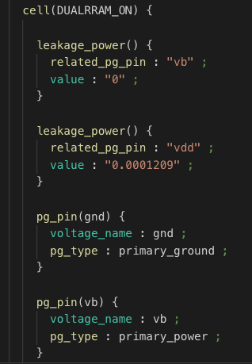
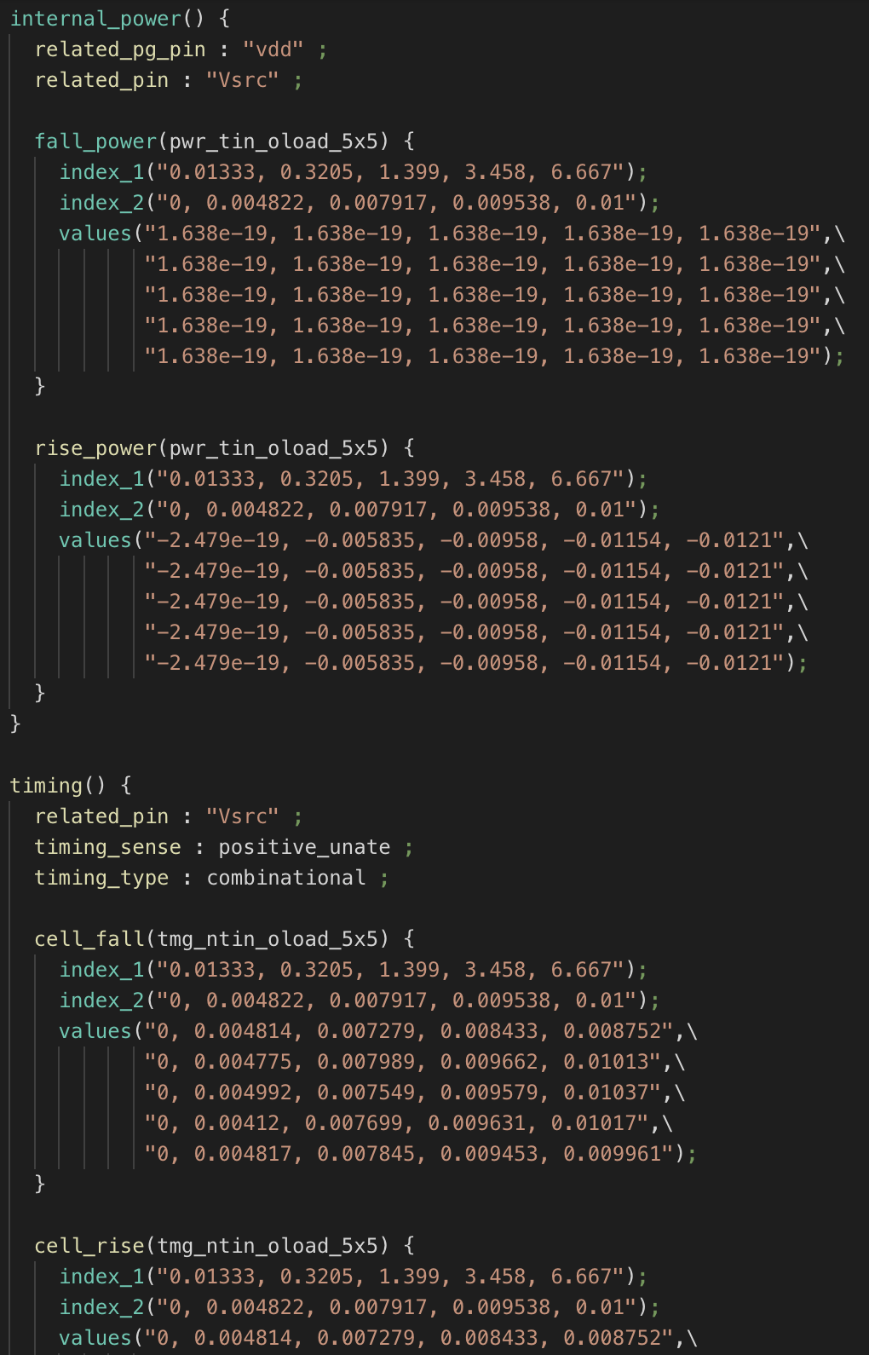
Current work on performance analysis
Characterizing HSPICE models for use in post-synthesis power/timing analysis
Generates Liberty files which can be plugged into PrimeTime for power/timing estimates in average case
Good first-order estimate of real energy/delay benefits
Next step: PnR+PEX+application mapping for better estimates
Characterization tables

Slide 60
Current synthesis-based performance estimates
TSMC40 LP SVT LIBRARY (Topo+Wireload) PE |  | Original design | RRAM with opt BUF muxes | RRAM with opt MUX muxes | NEM relays with decoders | NEM relays with RRAM
Area | Area (um^2) | 13306.7341 | 11029.41 | 9042.264197 | 10908.4 | 6938.69413
 | Area % Imp. | 0% | 17% | 32% | 18% | 48%
 | Area Benefits | 1 | 1.2064774 | 1.471615274 | 1.2198612 | 1.9177577
Power | Switch Power (mW) | 1.2558 | 1.2011 | 1.1004 | 1.335 | 1.1663
 | Int Power (mW) | 1.4134 | 1.296 | 1.2782 | 1.5336 | 1.2512
 | Leak Power (uW) | 1.2309 | 0.9744835 | 0.9094669 | 1.0799 | 0.8011903
 | Total Power (mW) | 2.6704309 | 2.4980745 | 2.379509467 | 2.8696799 | 2.41830119
 | Total Power % Imp. | 0% | 6% | 11% | -7% | 9%
 | Total Power Benefits | 1 | 1.0689957 | 1.122261095 | 0.9305675 | 1.10425902
Crit Path Delay | Delay (ns, target=1.8) | 1.8225 | 1.8888 | 1.7997 | 1.7995 | 1.8733
 | Delay % Imp. | 0% | -4% | 1% | 1% | -3%
 | Delay Benefits | 1 | 0.9648983 | 1.012668778 | 1.0127813 | 0.97288208
Energy | Energy Metric (ns*mW) | 4.866860315 | 4.7183631 | 4.282403188 | 5.163989 | 4.53020362
 | Energy % Imp. | 0% | 3% | 12% | -6% | 7%
 | Energy Benefits | 1 | 1.0314722 | 1.136478772 | 0.9424614 | 1.07431381
EDP | EDP Metric | 8.869852925 | 8.9120442 | 7.707041017 | 9.2925982 | 8.48643044
 | EDP % Imp. | 0% | 0% | 13% | -5% | 4%
 | EDP Benefits | 1 | 0.9952658 | 1.150876569 | 0.9545073 | 1.04518065
 | NEM Relay Area | 5888

Slide 61
Next steps for hybrid design
Use better SPICE models for NEM relays/RRAM
Use better power/delay models than SiliconSmart-generated Liberty
Do 3D place-and-route and estimate real performance
Verify hybrid scheme experimentally at least at small-scale

Slide 62
Experimental & theoretical demos with 2R AlO_{x}N_{y}
Project Description

Slide 63
Motivation
There is a tradeoff between read speed and read power in RRAM memory devices
In standard 1T1R configuration:
Read speed is highly dependent on resistance of HRS
Max read power is highly dependent on resistance of LRS
Area is highly dependent on transistor
Write speed is highly dependent on conduction mechanism, ON/OFF ratio, and current density achievable in technology
Alternatives:
Use selector-less design to reduce area and enable better 3D integration
Problem: suffers from sneak paths that prevent proper current sensing
Use 2R voltage divider scheme to prevent sneak path issues and get low power/high read speed
Tradeoff: write may be slower/higher power, area may be larger than 1R case

Slide 64
Background: Complementary Resistive Switches
Linn, Eike, Roland Rosezin, Carsten Kügeler, and Rainer Waser. "Complementary resistive switches for passive nanocrossbar memories." Nature materials 9, no. 5 (2010): 403.

Slide 65
Sneak Path Problem and Destructive Readout
CRS state | Memristive element A | Memristive element B | Resistance CRS
0 | HRS | LRS | ≈HRS
1 | LRS | HRS | ≈HRS
ON | LRS | LRS | LRS+LRS; only during read operation
OFF | HRS | HRS | ≫HRS; only in initial state
Linn, Eike, Roland Rosezin, Carsten Kügeler, and Rainer Waser. "Complementary resistive switches for passive nanocrossbar memories." Nature materials 9, no. 5 (2010): 403.

Slide 66
Non-destructive Read: Capacitive Voltage Divider with Voltage Readout
Tappertzhofen, S., E. Linn, L. Nielen, R. Rosezin, F. Lentz, R. Bruchhaus, I. Valov, U. Böttger, and R. Waser. "Capacity based nondestructive readout for complementary resistive switches." Nanotechnology 22, no. 39 (2011): 395203.

Slide 67
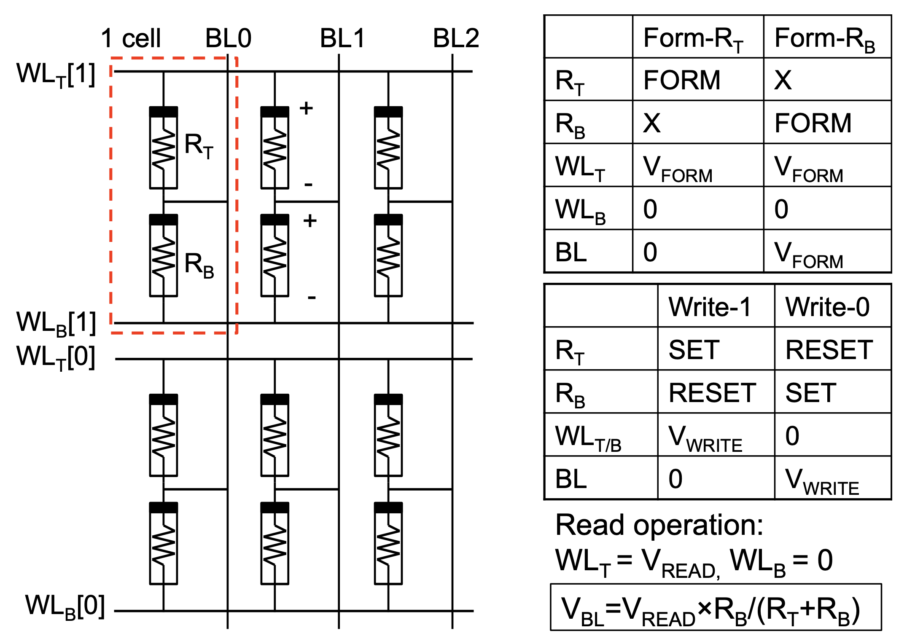
Non-destructive Read: Resistive Voltage Divider with Voltage Readout
Chiu, Pi-Feng, and Borivoje Nikolić. "A differential 2R crosspoint RRAM array with zero standby current." IEEE Transactions on Circuits and Systems II: Express Briefs 62, no. 5 (2014): 461-465.

Slide 68
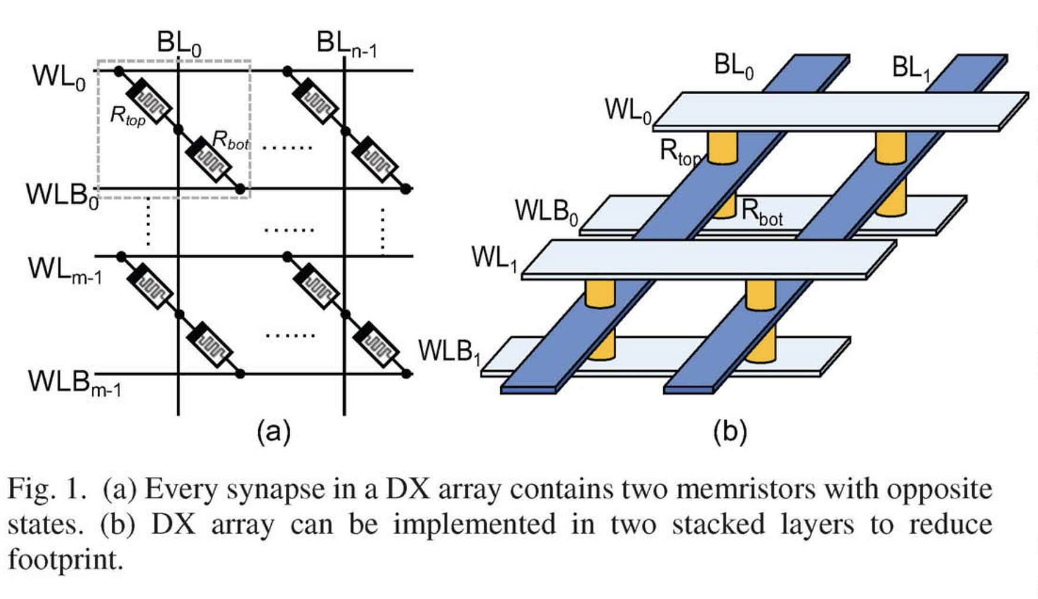
Differential 2R Crosspoint (DX) Array
Chiu, Pi-Feng, and Borivoje Nikolić. "A differential 2R crosspoint RRAM array with zero standby current." IEEE Transactions on Circuits and Systems II: Express Briefs 62, no. 5 (2014): 461-465.

Slide 69
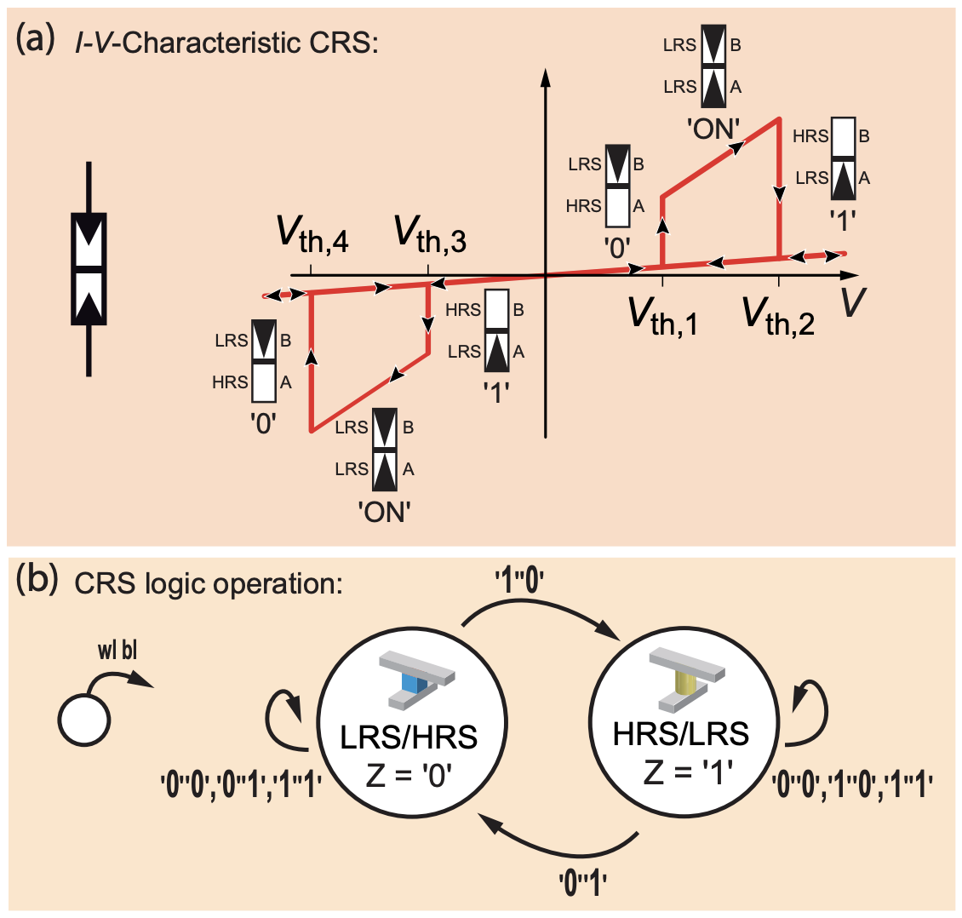
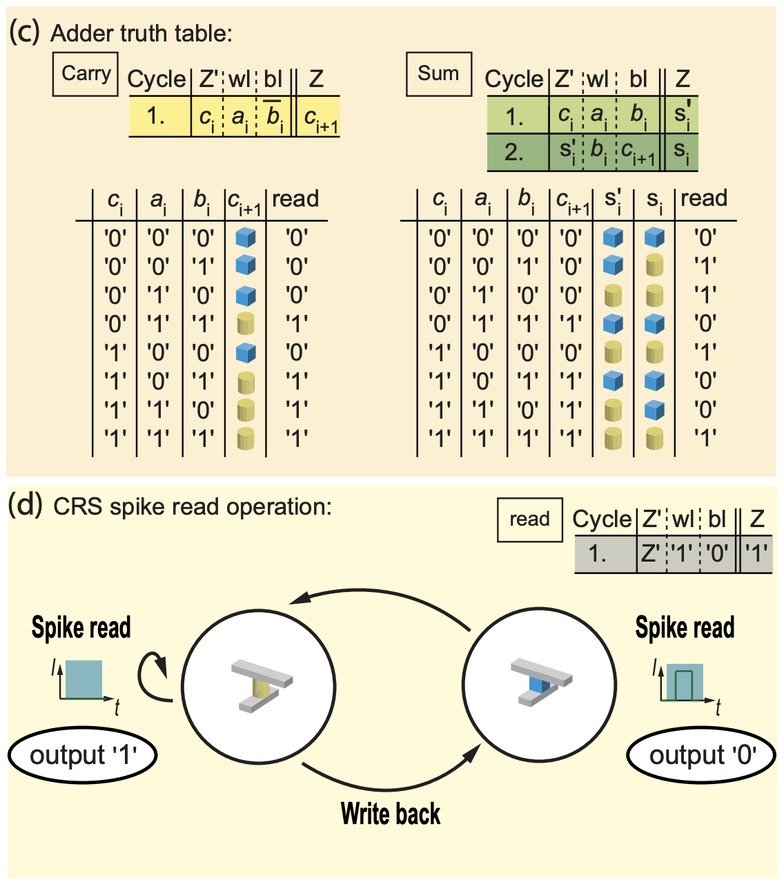
CRS Addition Unit
Siemon, Anne, Stephan Menzel, Rainer Waser, and Eike Linn. "A complementary resistive switch-based crossbar array adder." IEEE journal on emerging and selected topics in circuits and systems 5, no. 1 (2015): 64-74.

Slide 70
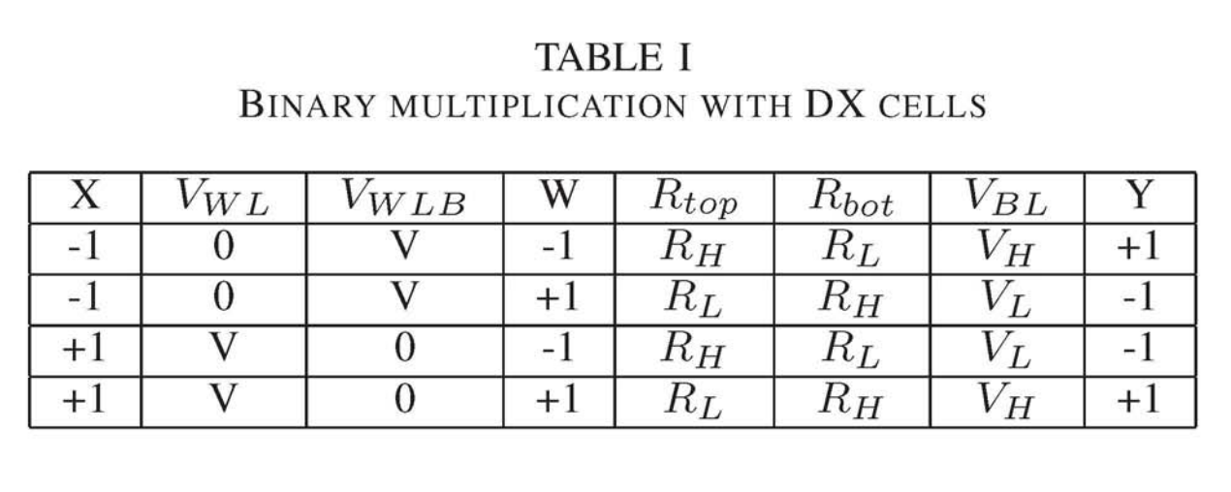
Binarized DX Crosspoint MAC Unit
Table I lists the four cases of multiplying two binary numbers (+1 and -1), where X is the input, W is the weight, and Y is the output. To represent an input of -1, WL is tied to ground and WLB is connected to V. The connections are flipped when representing input of +1. For different weight values, the top memristor (R_{top}) is programmed to HRS (R_{H}) when W is -1 and to LRS (Rd when W is +1. The bottom memristor (R_{bot}) is programmed in the opposite fashion. As a result, the output voltage on BL matches the truth table perfectly. V_{H} = V (RH / (RH + RL)) corresponds to Y = +1 and V_{L} = V (RL / (RH + RL)) corresponds to Y = -1.
Accumulation value works out with HRS/LRS > 10⁵: activate all
Chiu, Pi-Feng, Won Ho Choi, Wen Ma, Minghai Qin, and Martin Lueker-Boden. "A Binarized Neural Network Accelerator with Differential Crosspoint Memristor Array for Energy-Efficient MAC Operations." In 2019 IEEE International Symposium on Circuits and Systems (ISCAS), pp. 1-5. IEEE, 2019.

Slide 71
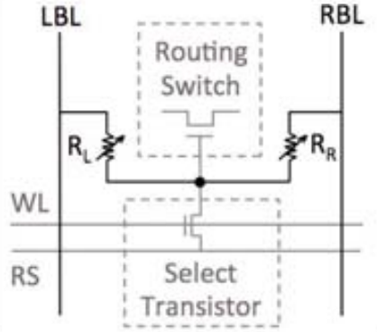
2R vs. 1T2R: Programmable Voltage Divider
Alternative:
Program directly from LBL to RBL
No programming WL needed for full 3D
Direct control plane memory
Small static current w/high HRS
Liauw, Young Yang, Zhiping Zhang, Wanki Kim, Abbas El Gamal, and S. Simon Wong. "Nonvolatile 3D-FPGA with monolithically stacked RRAM-based configuration memory." In 2012 IEEE International Solid-State Circuits Conference, pp. 406-408. IEEE, 2012.

Slide 72
Multi-bit-per-cell RRAM
Project Description

Slide 73
Optimal Programming Algorithm
Examine process technology and effect of PW/BL/WL on tuning
Sigma-based level range allocation
Thresholded push-in (ThreshPush) algorithm
Tradeoffs in power/speed/complexity:
Longer pulse widths give better resistance control but use more power
An optimal algorithm may be too complex to implement efficiently

Slide 74
MLC Digital MAC unit vs. Analog MAC unit
Apples-to-apples comparison of digital and analog matrix multiplication approaches for deep learning and other applications
Baseline: binary memory module connected to digital MAC unit
MLC: multi-bit digital memory module connected to digital MAC unit
CIM: analog compute-in-memory
Benchmarks:
Application-level accuracy (%)
Area (um^2)
Power (TOPS/W)
Performance (inf/s)

Slide 75
Thank you!
Questions?

Slide 76
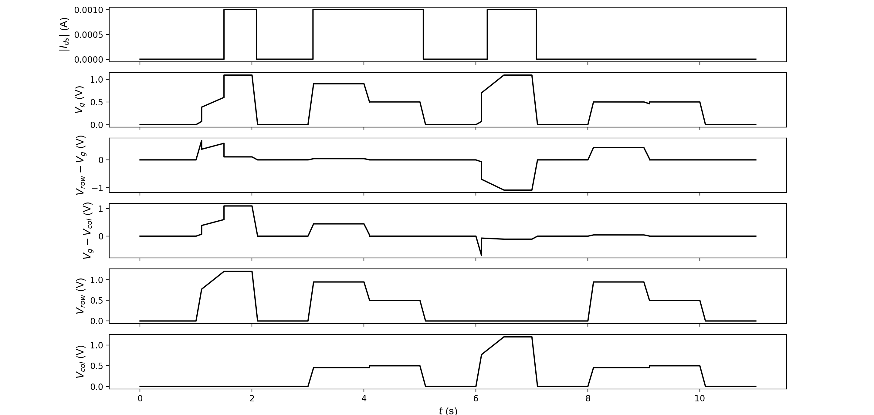
Backup Slide: Time trace of valid state transitions
MODE:
OFF_0
SET
OFF_1
COPY_1
HOLD_1
OFF_1
RESET
OFF_0
COPY_0
HOLD_0
OFF_0

Slide 77
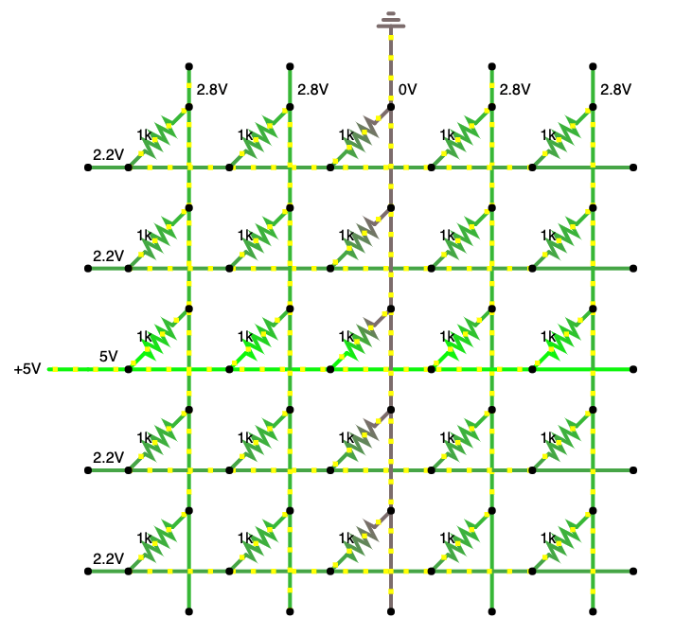
Double voltage and half-select problem
Possibly need ~2*|V_{SET}| voltage capability
Avoiding write disturbance requires RRAM to have asymmetric SET/RESET voltages
Approximately speaking:
|V_{SET}| > |V_{RST}| for V/2 scheme
Can use V/3 scheme

Slide 78
Backup Slide: Row/col controllers
Notes:
(single stream for reduced I/O pin requirement)
Probably want to do this on-chip to reduce pin requirement
Column controller is similar

Slide 79
Backup: CGRA
Coarse Grained Reconfigurable Array (CGRA)
PE
MEM
PE
MEM
Tile
PE
MEM
PE
MEM
PE
MEM
PE
MEM
 | Processing Element
 | (PE) / Compute
 | Memory (MEM)
 | Switch box (SB)
 | Connection box (CB)
PE
MEM
PE
MEM

Slide 80


Backup Slide: PE Layouts (~90um x 90um)
View from Synopsys IC Compiler
GDSII stream-out loaded into Cadence Virtuoso

Slide 81
Backup Slide: Connection Box (CB)
10-to-1 mux
10 vertical 16 bit tracks
5 driven up, 5 driven down
PE
A
CB
B
CB
There are similar 1 bit CBs for feeding 1 bit inputs from 10 horizontal and vertical 1 bit tracks
SB
10 horizontal 16 bit tracks
5 driven left, 5 driven right

Slide 82
Backup Slide: Switch Box (SB)
4
3
2
1
0
4
3
2
1
0
PE
Pipeline register
4
3
2
1
0
4
3
2
1
0
4
3
2
1
0
4
3
2
1
0
4
3
2
1
0
4
3
2
1
0

Slide 83
Backup Slide: Switch Box (SB)
4
3
2
1
0
4
3
2
1
0
PE
4
3
2
1
0
4
3
2
1
0
4
3
2
1
0
4
3
2
1
0
Figure shows connectivity for ‘0’ tracks
Similar connectivity for all other numbered tracks
PE output goes to all muxes
4
3
2
1
0
4
3
2
1
0

Slide 84
Backup Slide: Processing Element (PE)
Two 16 bit operands
Three 1 bit operands
A
B
D
E
F
RegA
RegB
RegC
RegD
RegE
Add
Mult
And
8 entry
1 bit look-up table
…
flag
ALU
result

Slide 85


Backup Slide: Valid state transitions
V_{col,1}
V_{col,2}
src_{1,1}
src_{1,2}
drn_{1,1}
drn_{1,2}
V_{g}
-
+
+
-
V_{row,1}
src_{2,1}
src_{2,2}
drn_{2,1}
drn_{2,2}
V_{g}
V_{row,2}
out
Hysteretic 4T NEM Router
RRAM Cell

Slide 86
Backup Slide: NEM Relay Process Flow

Slide 87
Backup Slide: RRAM Process Flow Step 1: Large 1R ALD RRAM (80um x 80um)
Steps 1-4 need to be done consecutively without breaking vacuum
1. Deposit 20nm TiN with ALD on fiji1/2
Plasma TiN recipe
0.6-0.7 A/cycle
Tetrakis(dimethylamido)titanium(IV) @ 75C, N2 plasma (which order in recipe?)
2. Deposit 4nm AlN with ALD on fiji1/2
Plasma AlN recipe
TMA, N2 plasma
0.8 A/cycle
3. Deposit 5nm Al2O3 with ALD on fiji1/2
Thermal Al2O3 recipe (standard)
TMA, DI water @ 200C (or O2 plasma?)
0.92 A/cycle = 50 cycles
4. Deposit 20nm TiN with ALD on fiji1/2
Plasma TiN recipe
0.6-0.7 A/cycle
Tetrakis(dimethylamido)titanium(IV) @ 75C, N2 plasma (which order in recipe?)
5. Anneal @ 400C for 15 minutes for diffusion
6. Deposit top contact material
7. Pattern and etch

Slide 88
Backup Slide: RRAM Process Flow Step 2: Large 2R ALD RRAM (80um x 80um)
Do 1R fabrication twice in reverse order for anti-serial configuration
Will this work?
Can AlN grow on AlO?
If not, can make structures separately and share top contact

Slide 89
Backup Slide: RRAM Process Flow Step 3++: Selector-less Xpoint Arrays
Many configurations to try
Start simple and try more complicated
Simplest: CRS array
More complex: DX array
Try with small array sizes and large cells
Scale down, use e-beam to go sub-micron

Slide 90
Backup Slide: Reconfigurable routing: detail
10 vertical 16 bit tracks
5 driven up, 5 driven down
10-to-1 mux
PE
A
CB
Area dominated by interconnect components!
B
CB
There are similar 1 bit CBs for feeding 1 bit inputs from 10 horizontal and vertical 1 bit tracks
SB
10 horizontal 16 bit tracks
5 driven left, 5 driven right

